Slide 1
STT 200_Fall 2019
Statistical Methods
Chapter 3_Part 1
Inference for Categorical Data

Slide 2
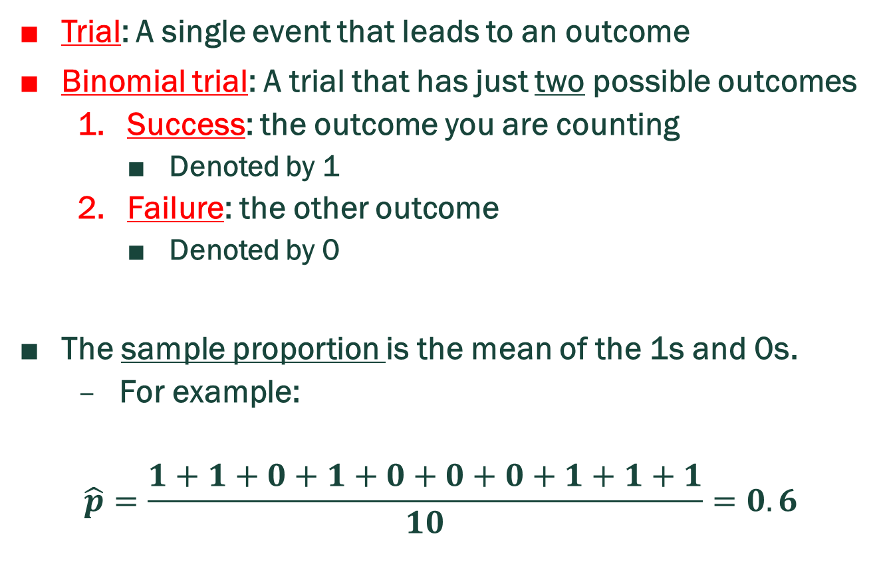
Vocabulary
Trial: A single event that leads to an outcome
Binomial trial: A trial that has just two possible outcomes
  Success: the outcome you are counting
    Denoted by 1
  Failure: the other outcome
    Denoted by 0
The sample proportion is the mean of the 1s and 0s.
  For example:
$$\hat{p}=\frac{1+1+0+1+0+0+0+1+1+1}{10}=0.6$$

Slide 3
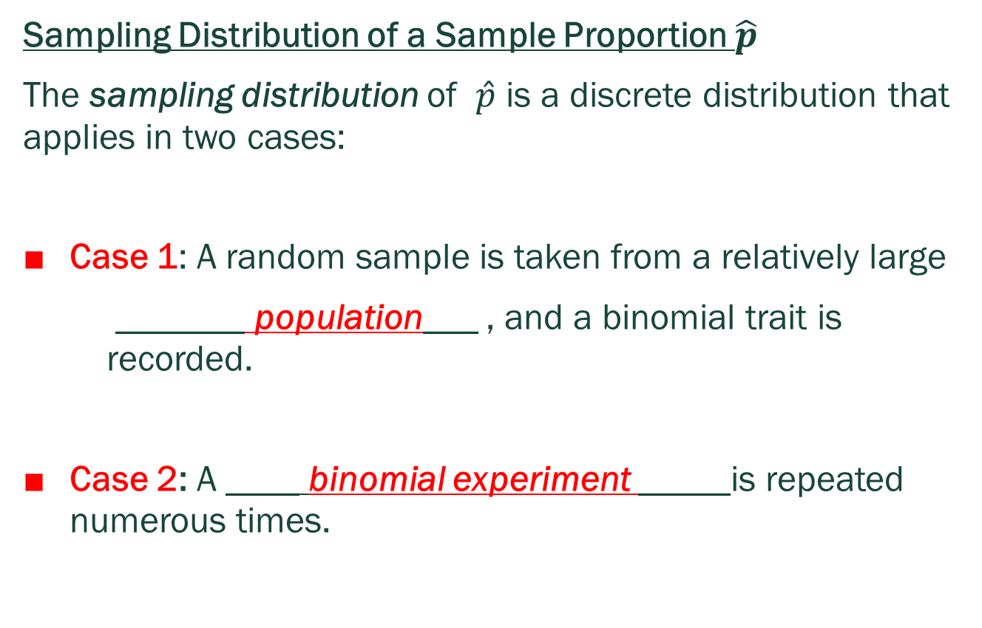
Inference for a Single Population Proportion
Sampling Distribution of a Sample Proportion $\hat{p}$
The sampling distribution of $\hat{p}$ is a discrete distribution that applies in two cases:
Case 1: A random sample is taken from a relatively large
_______ population___ , and a binomial trait is recorded.
Case 2: A ____ binomial experiment _____is repeated numerous times.

Slide 4
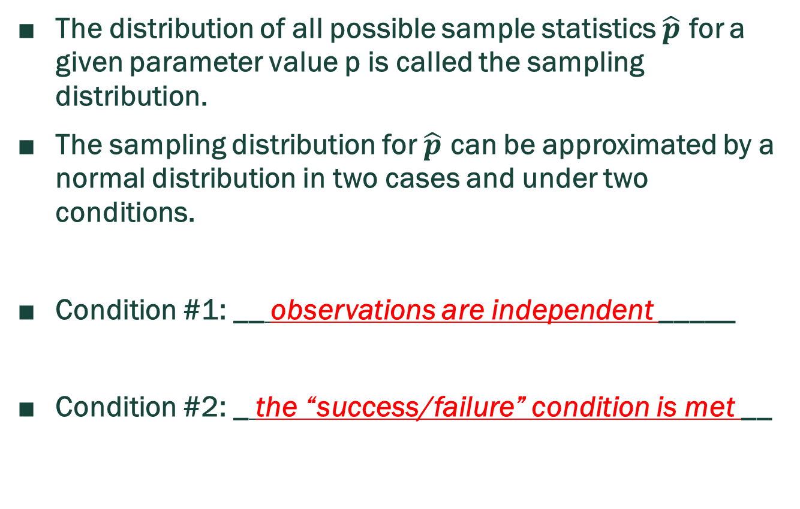
Sampling Distribution For $\hat{p}$
The distribution of all possible sample statistics $\hat{p}$ for a given parameter value p is called the sampling distribution.
The sampling distribution for $\hat{p}$ can be approximated by a normal distribution in two cases and under two conditions.
Condition #1: __ observations are independent _____
Condition #2: _ the “success/failure” condition is met __

Slide 5
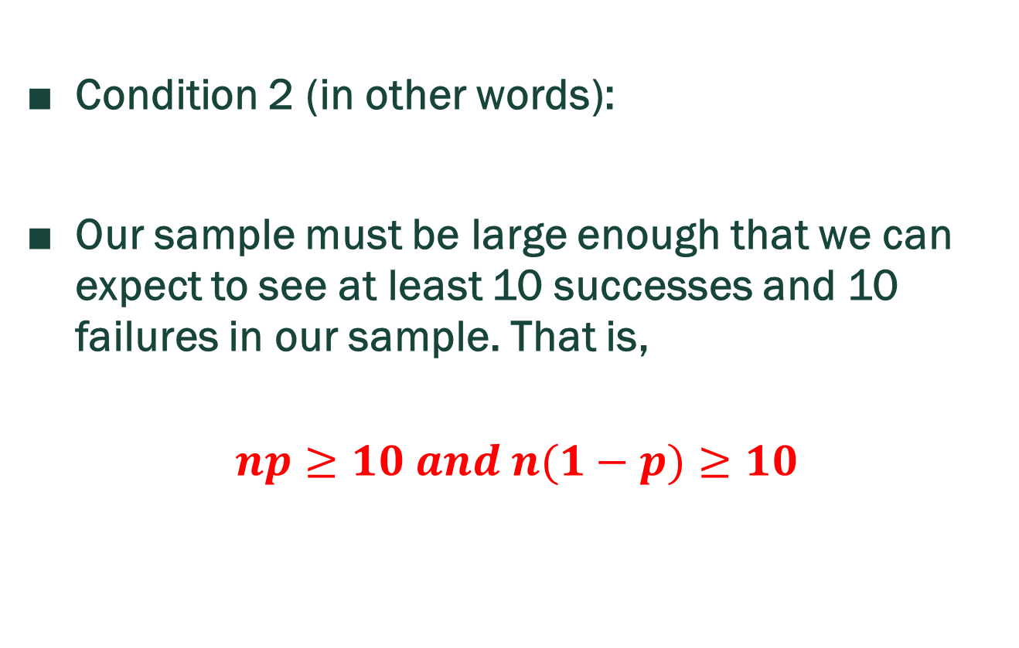
Expected Success/Failure Condition
Condition 2 (in other words):
Our sample must be large enough that we can expect to see at least 10 successes and 10 failures in our sample. That is,
$$np≥10 and n(1−p)≥10$$

Slide 6
If conditions are met
The normal model for sampling distribution of possible sample proportions:
The mean of this normal distribution is ____ p _____, the true population proportion.

Slide 7
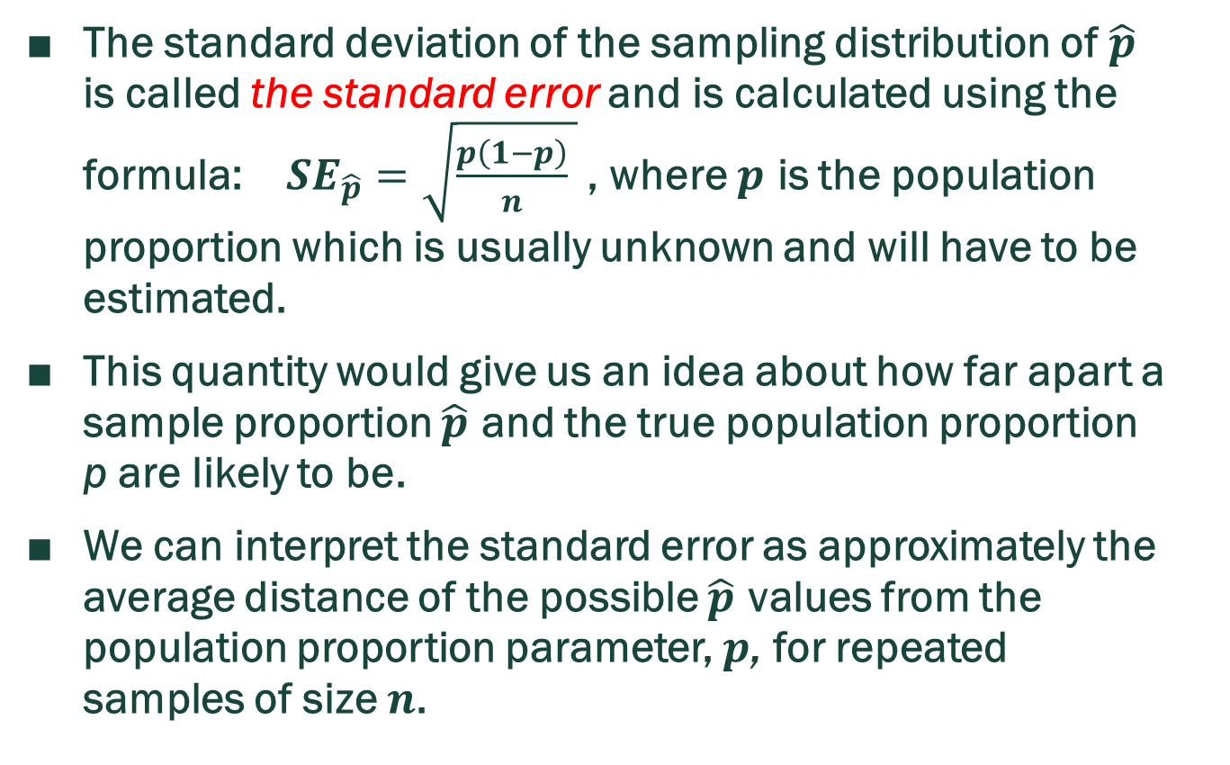
More On $SE_{\hat{p}}$
The standard deviation of the sampling distribution of $\hat{p}$ is called the standard error and is calculated using the formula: $SE_{\hat{p}}=\sqrt{\frac{p\left(1−p\right)}{n} }$ , where $p$ is the population proportion which is usually unknown and will have to be estimated.
This quantity would give us an idea about how far apart a sample proportion $\hat{p}$ and the true population proportion p are likely to be.
We can interpret the standard error as approximately the average distance of the possible $\hat{p}$ values from the population proportion parameter, $p$, for repeated samples of size $n$.

Slide 8

Example: B+ Blood (1)
10% of adults have a B+ blood-type. Suppose a RS of 180 adults is selected and their blood type recorded. Let $\hat{p}$ represent the proportion of this 180-person sample who will have B+ blood.
a. Provide a sketch of the normal model we could use to approximate the distribution of the sample proportion $\hat{p}$.

Slide 9

Example: B+ Blood (2)
b. How likely would it be for the sample proportion $\hat{p}$ to fall further than 4% from the true population proportion $p=0.10$?

Slide 10

Example: B+ Blood (3)
c. Complete the following sentence: If we took repeated random samples of 180 individuals, we would expect $\hat{p}$ to fall between _______ and _______ about 95% of the time.

Slide 11
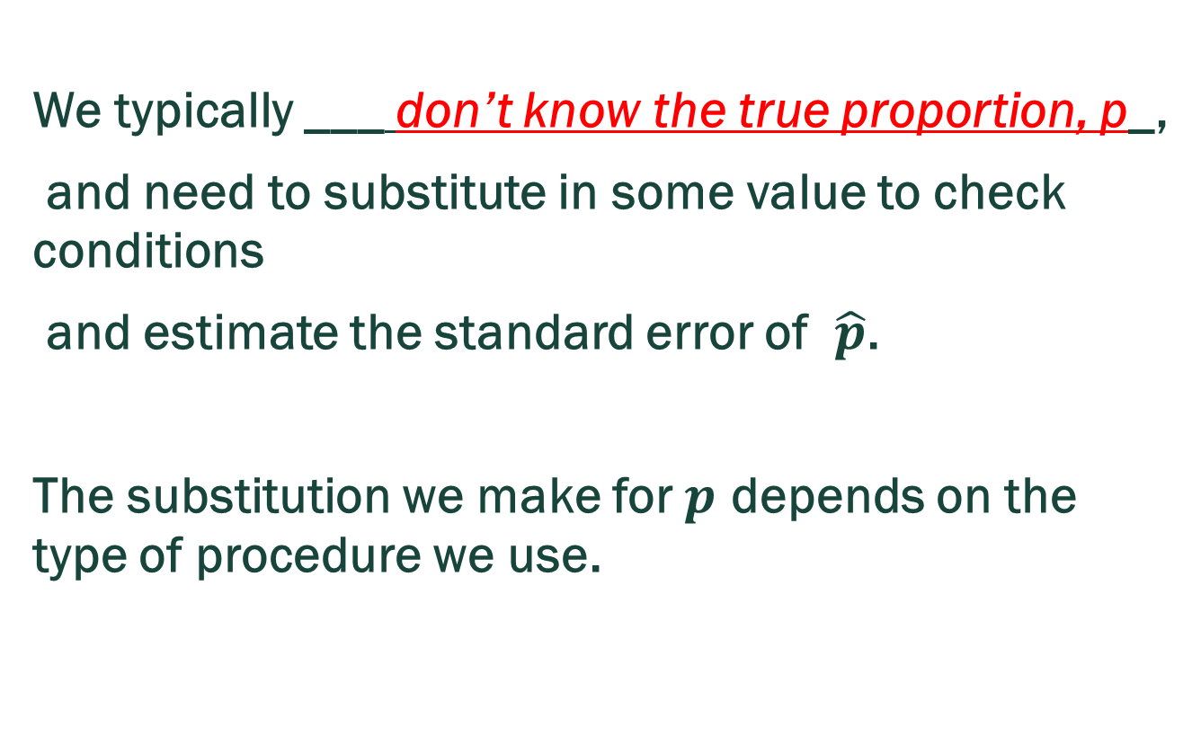
Computing The Standard Error of $\hat{p}$
We typically ___ don’t know the true proportion, p_,
and need to substitute in some value to check conditions
and estimate the standard error of $\hat{p}$.
The substitution we make for $p$ depends on the type of procedure we use.

Slide 12
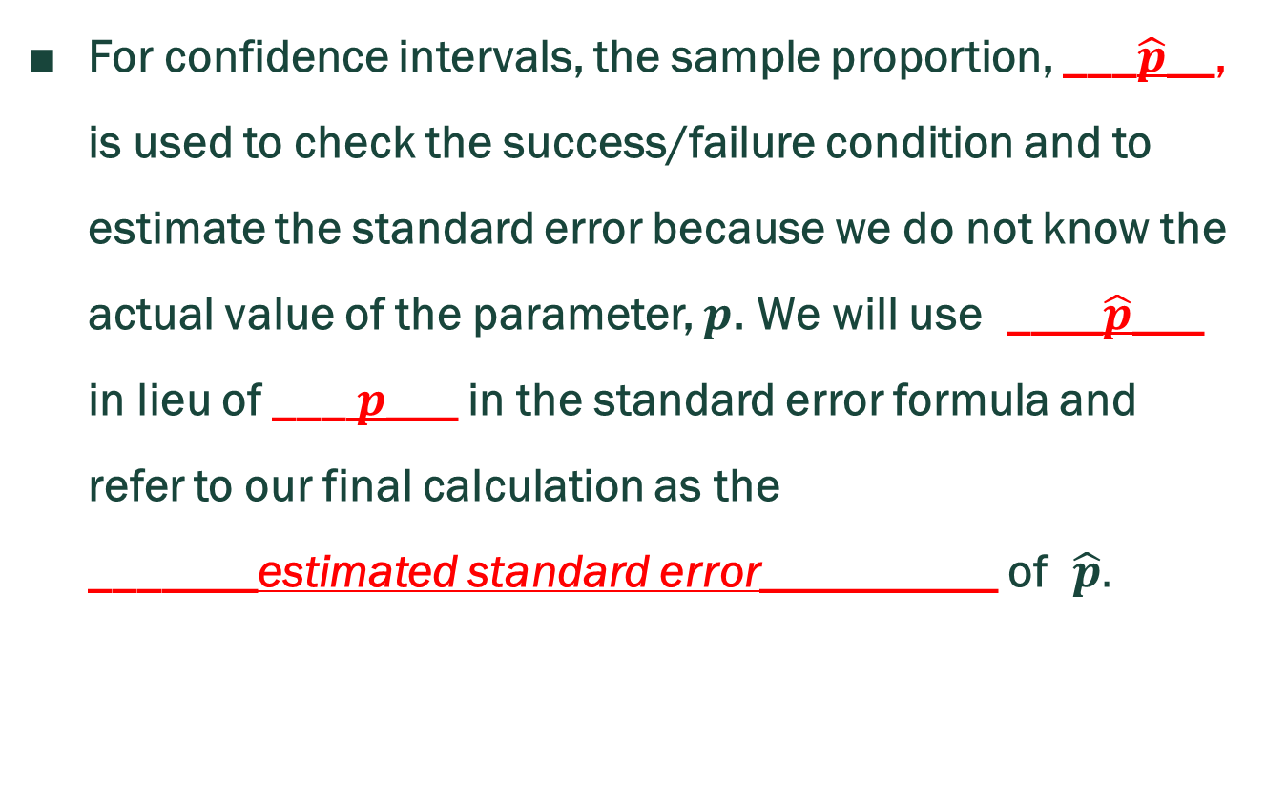
$SE_{\hat{p}}$ For Confidence Intervals
For confidence intervals, the sample proportion, ___$\hat{p}$__, is used to check the success/failure condition and to estimate the standard error because we do not know the actual value of the parameter, $p$. We will use ____$\hat{p}$___ in lieu of ___$p$___ in the standard error formula and refer to our final calculation as the
_______estimated standard error__________ of $\hat{p}.$

Slide 13

Expected Success/Failure
Check For Confidence Intervals:
Pay attention to notation!
$$n\hat{p}≥10 and n(1−\hat{p})≥10$$

Slide 14
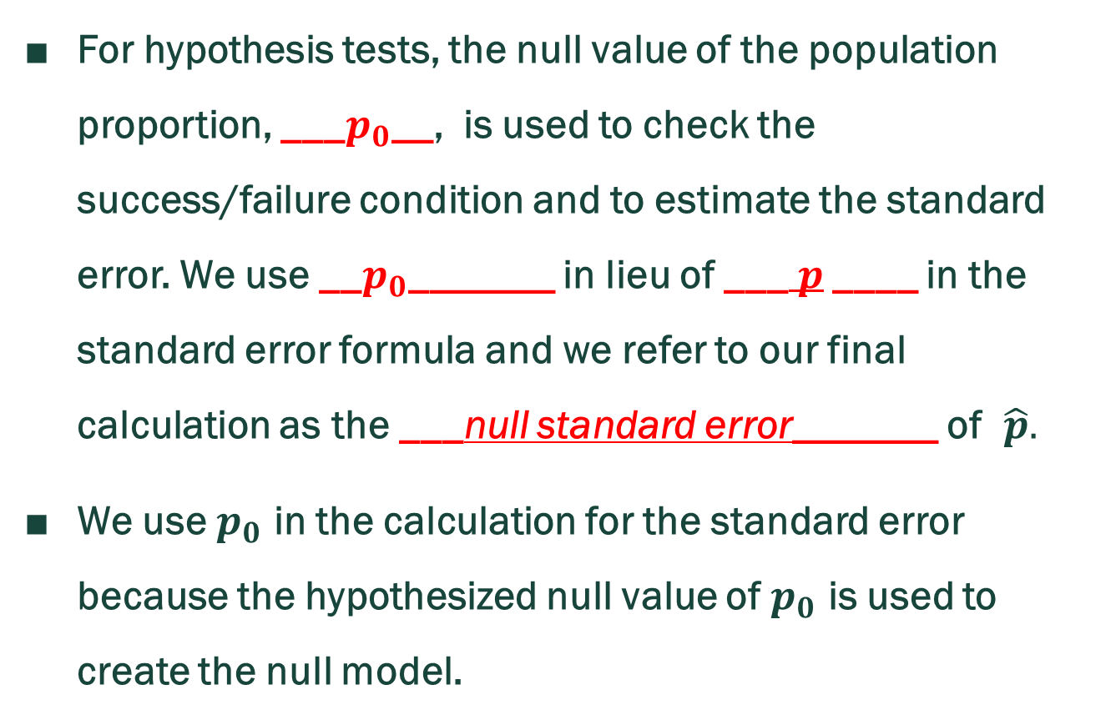
$SE_{\hat{p}}$ For Hypothesis Tests
For hypothesis tests, the null value of the population proportion, ___$p_{0}$__, is used to check the success/failure condition and to estimate the standard error. We use __$p_{0}$_______ in lieu of ___$p$ ____ in the standard error formula and we refer to our final calculation as the ___null standard error_______ of $\hat{p}.$
We use $p_{0}$ in the calculation for the standard error because the hypothesized null value of $p_{0}$ is used to create the null model.

Slide 15

Expected Success/Failure
Check For Hypothesis Tests
Pay attention to notation!
$$np_{0}≥10 and n(1−p_{0})≥10$$

Slide 16
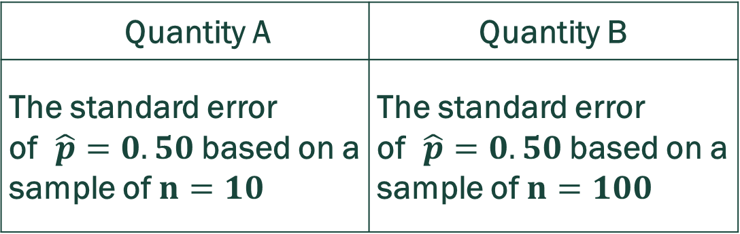
Self-practice Example: Comparing $SE_{\hat{p}}$ (1)
Which is the correct statement?
Quantity A is greater
Quantity B is greater
The quantities are the same
The relationship cannot be determined without more information
Quantity A | Quantity B
The standard error of $\hat{p}=0.50$ based on a sample of $n=10$ | The standard error of $\hat{p}=0.50$ based on a sample of $n=100$

Slide 17
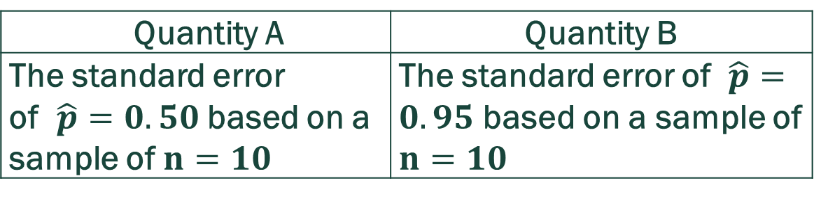
Self-practice Example: Comparing $SE_{\hat{p}}$ (2)
Which is the correct statement?
Quantity A is greater
Quantity B is greater
The quantities are the same
The relationship cannot be determined without more information
Quantity A | Quantity B
The standard error of $\hat{p}=0.50$ based on a sample of $n=10$ | The standard error of $\hat{p}=0.95$ based on a sample of $n=10$

Slide 18
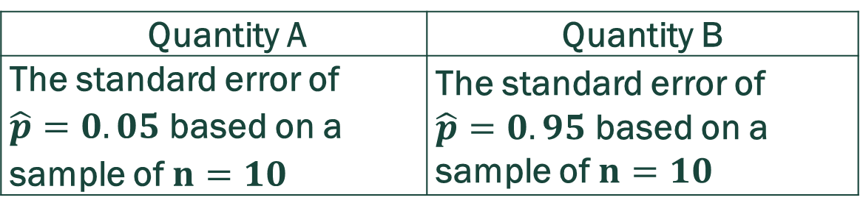
Self-practice Example: Comparing $SE_{\hat{p}}$ (3)
Which is the correct statement?
Quantity A is greater
Quantity B is greater
The quantities are the same
The relationship cannot be determined without more information
Quantity A | Quantity B
The standard error of $\hat{p}=0.05$ based on a sample of $n=10$ | The standard error of $\hat{p}=0.95$ based on a sample of $n=10$

Slide 19
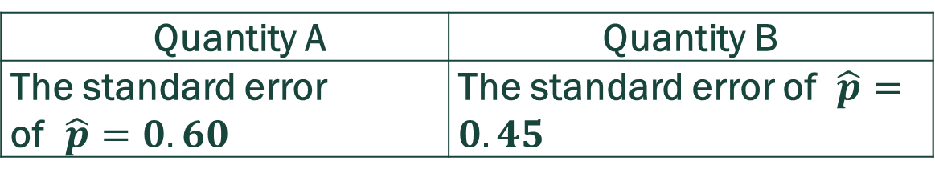
Self-practice Example: Comparing $SE_{\hat{p}}$ (4)
Which is the correct statement?
Quantity A is greater
Quantity B is greater
The quantities are the same
The relationship cannot be determined without more information
Quantity A | Quantity B
The standard error of $\hat{p}=0.60$ | The standard error of $\hat{p}=0.45$

Slide 20
Self-practice Examples: Comparing SE
Answers
1. A
2. A
3. C
4. D

Slide 21
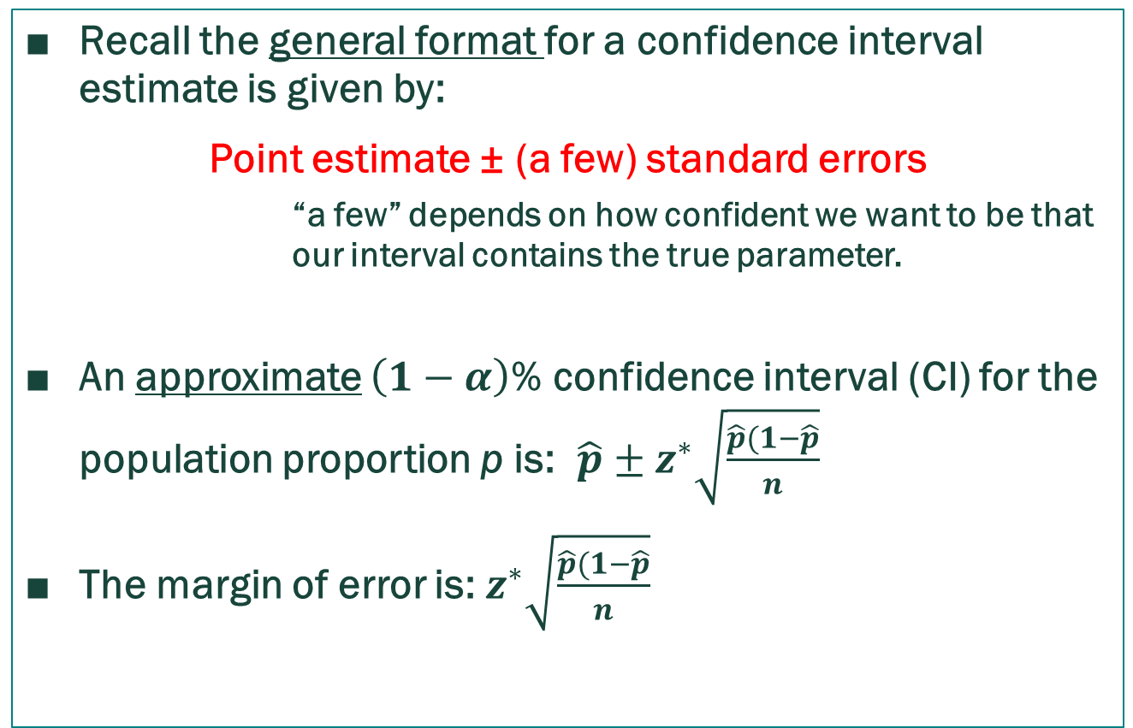
Confidence Intervals For a Single Proportion
Recall the general format for a confidence interval estimate is given by:
Point estimate ± (a few) standard errors
        “a few” depends on how confident we want to be that our interval contains the true parameter.
An approximate $\left(1−α\right)$% confidence interval (CI) for the population proportion p is: $\hat{p}±z^{∗}\sqrt{\frac{\hat{p}(1−\hat{p}}{n}}$
The margin of error is: $z^{∗}\sqrt{\frac{\hat{p}(1−\hat{p}}{n}}$

Slide 22
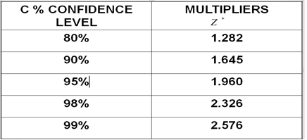

Slide 23
Example: What Is The Ideal Family Size? (1)
In 2018 a random sample of 1,017 American adults was asked the question, “What do you think is the ideal number of children for a family to have?” Results showed that 41% of respondents said three or more children is ideal.
a. How many of the respondents surveyed think that three or more children is the ideal family size?

Slide 24
Example: What is the ideal family size? (2)
b. Calculate a 90% confidence interval for the proportion of Americans who think that three or more children is the ideal family size and interpret the interval in context.
c. A 95% confidence interval produced from the same survey results would be
narrower wider the same width as
the interval computed in (b).

Slide 25
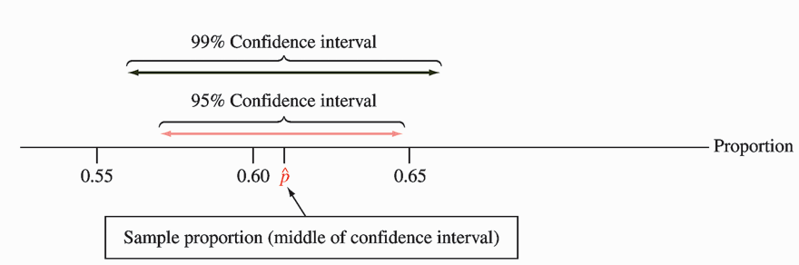
A 99% Confidence Interval is Wider Than a 95% Confidence Interval

Slide 26

Self-read Example: Getting Along With Parents (1)
In a Gallup Youth Survey n = 501 randomly selected American teenagers were asked about how well they get along with their parents. One survey result was that 54% of the sample said they get along “VERY WELL” with their parents.
The sample proportion was found to be 0.54. Check the expected success/failure condition.

Slide 27

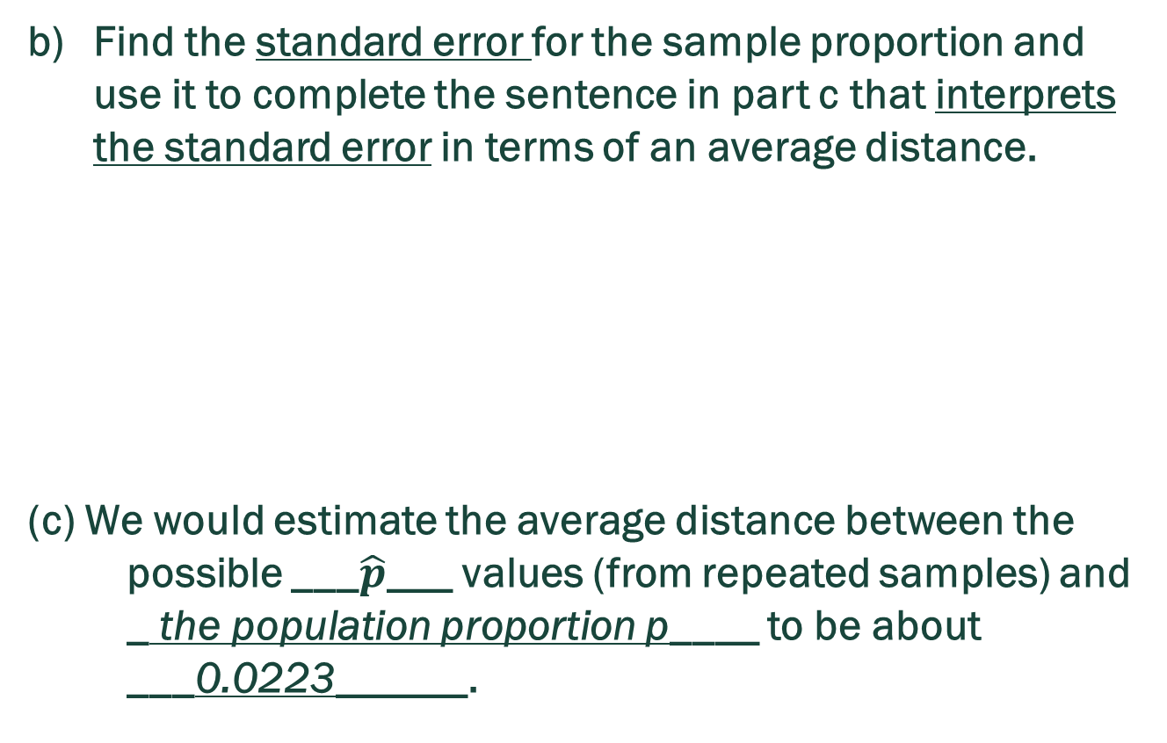
Self-read Example: Getting Along With Parents (2)
Find the standard error for the sample proportion and use it to complete the sentence in part c that interprets the standard error in terms of an average distance.
(c) We would estimate the average distance between the possible ___$\hat{p}$___ values (from repeated samples) and
_ the population proportion p____ to be about ___0.0223______.

Slide 28
Self-read Example: Getting Along With Parents (3)
Compute a 95% confidence interval for the population proportion of teenagers that get along very well with their parents.
Lower bound = 0.54 – 1.96*0.0223 = 0.4963
Upper bound = 0.54 + 1.96*0.0223 = 0.5837
95% Confidence Interval = (0.4963, 0.5837)

Slide 29
Self-read Example: Getting Along With Parents (4)
Fill in the blanks for the typical interpretation of the confidence interval in part d:
“Based on this sample, with 95% confidence, we would estimate that somewhere between __49.63%___ and __58.37%_ of all American teenagers think they get along very well with their parents.”
Can we say that the probability that the above (already observed) interval (0.4963, 0.5837) contains the population proportion p is 0.95? Answer = No!

Slide 30
Example: Is College Worth It?_SIMILAR TO HW6 PROBLEM 6
Among a simple random sample of 300 American adults who do not have a four-year college degree and are not currently enrolled in school, 135 said they decided not to go to college because they could not afford school.
(1) Calculate a 98% confidence interval for the proportion of Americans who decide to not go to college because they cannot afford it and interpret the interval in context. Round to 4 decimal places.

Slide 31
Example: Is College Worth It?_SIMILAR TO HW6 PROBLEM 6
(2) Suppose we wanted the margin of error for the 98% confidence level to be about 2%. What is the smallest size, n, we could take to achieve this?

Slide 32
Solution to (1) Using TI – 84 Calculator
Press [STAT].
Select [TESTS].
Choose A: 1-PropZInt….
Input the following:
  x: 135
  n: 300
  C-Level: 0.98
Choose Calculate and press [ENTER].
Solution: (0.3832, 0.5168)

Slide 33
Choosing a Sample Size When Estimating
Many times, once we have calculated a confidence interval for a population parameter, we find that the interval is too wide to be useful. In such a case, we would like to reduce the margin of error.
Recall that the margin of error for a confidence interval is

Slide 34
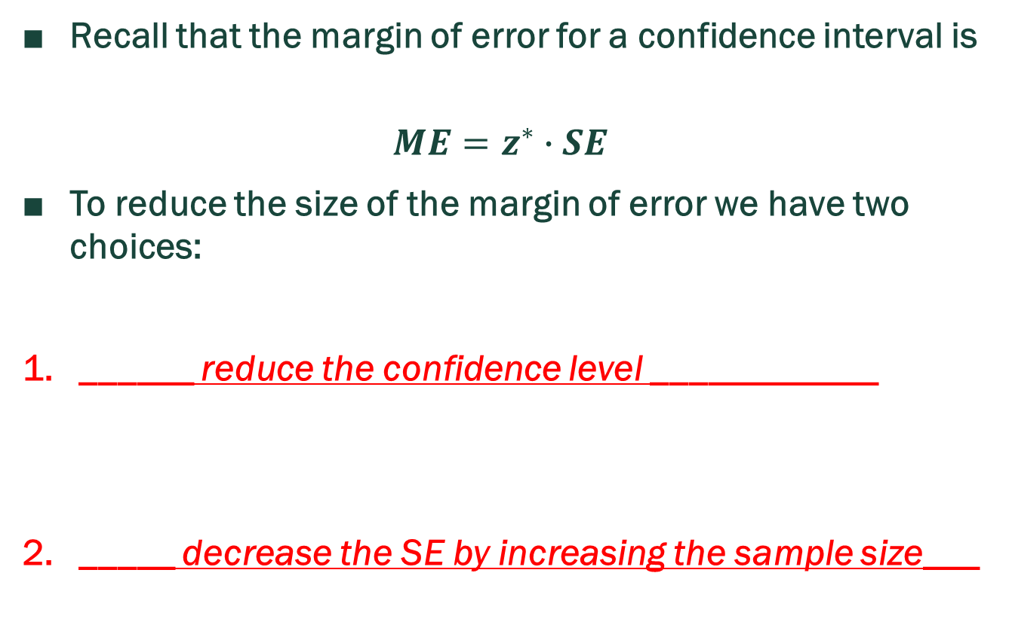
Choosing a Sample Size When Estimating
Recall that the margin of error for a confidence interval is
$$ME=z^{∗}∙SE$$
To reduce the size of the margin of error we have two choices:
______ reduce the confidence level ____________
_____ decrease the SE by increasing the sample size___

Slide 35
Costs and Benefits
Reducing the confidence level from say, 95% to 90% will give us a ___narrower____ interval but will also increase our ____uncertainty_____ about whether the parameter is in our interval.
______Increasing the sample size________ can narrow the interval without increasing uncertainty, but it involves extra financial costs to collect more data.

Slide 36
Remark
In this section, we will investigate how to find the minimum sample size necessary to achieve a desired margin of error for our confidence interval.
Generally, we plug in a suitable value for the multiplier for the confidence level we plan to use, write in the formula for the standard error, and them solve for the sample size, n.

Slide 37
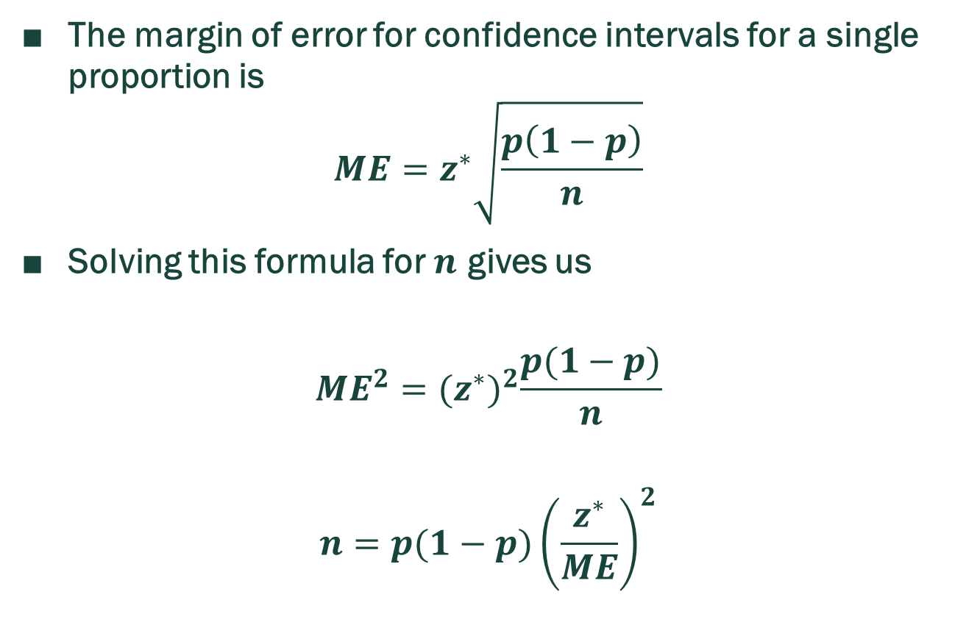
Sample Size, n, For Confidence Intervals For Proportions
The margin of error for confidence intervals for a single proportion is
$$ME=z^{∗}\sqrt{\frac{p\left(1−p\right)}{n}}$$
Solving this formula for $n$ gives us
$${ME}^{2}={(z^{∗})}^{2}\frac{p(1−p)}{n}$$
$$n=p(1−p){\left(\frac{z^{∗}}{ME}\right)}^{2}$$

Slide 38

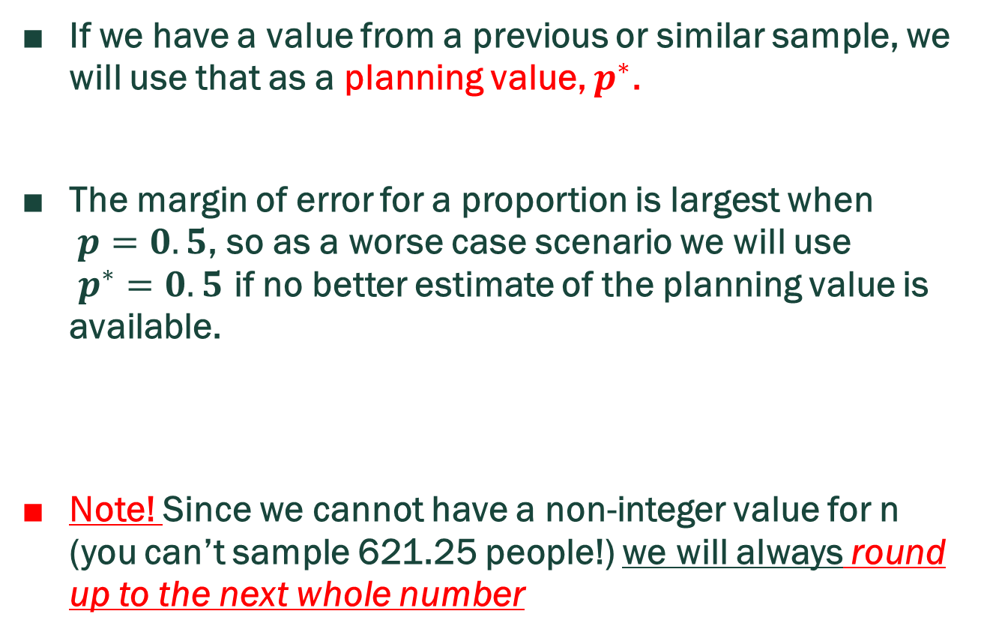
Planning Value For p
If we have a value from a previous or similar sample, we will use that as a planning value, $p^{∗}$.
The margin of error for a proportion is largest when
$p=0.5$, so as a worse case scenario we will use
$p^{∗}=0.5$ if no better estimate of the planning value is available.
Note! Since we cannot have a non-integer value for n (you can’t sample 621.25 people!) we will always round up to the next whole number

Slide 39
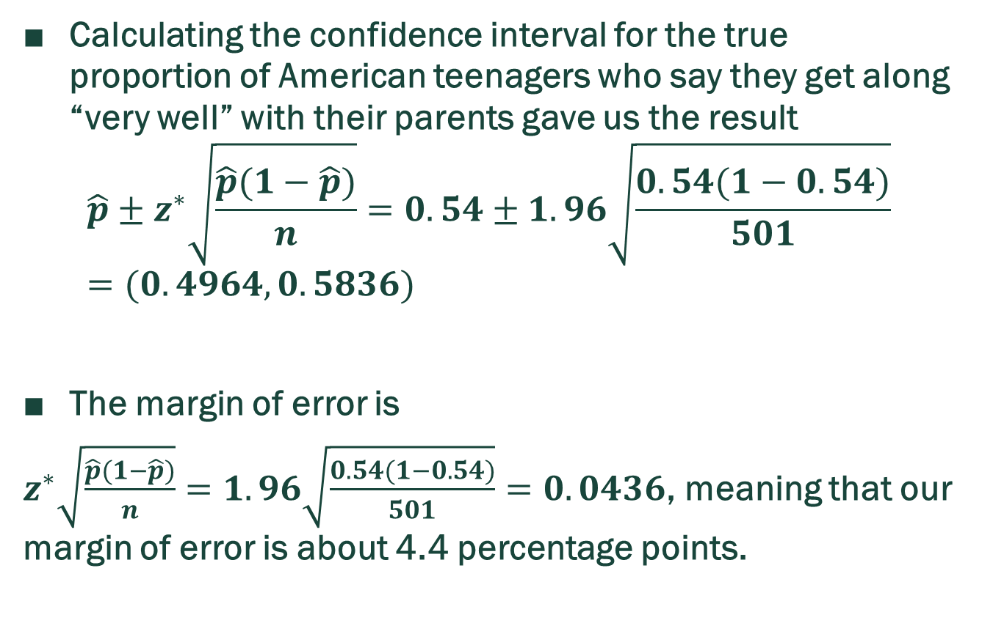
Example: Revisiting Getting Along With Parents Again
Calculating the confidence interval for the true proportion of American teenagers who say they get along “very well” with their parents gave us the result
$$\hat{p}±z^{∗}\sqrt{\frac{\hat{p}(1−\hat{p})}{n}}=0.54±1.96\sqrt{\frac{0.54(1−0.54)}{501}}=(0.4964, 0.5836)$$
The margin of error is
$z^{∗}\sqrt{\frac{\hat{p}(1−\hat{p})}{n}}=1.96\sqrt{\frac{0.54(1−0.54)}{501}}=0.0436$, meaning that our margin of error is about 4.4 percentage points.

Slide 40
Smaller ME
Suppose we want a margin of error less than 0.03? What size sample should we take?
Calculate the sample size needed for a margin of error less than 0.01.

Slide 41

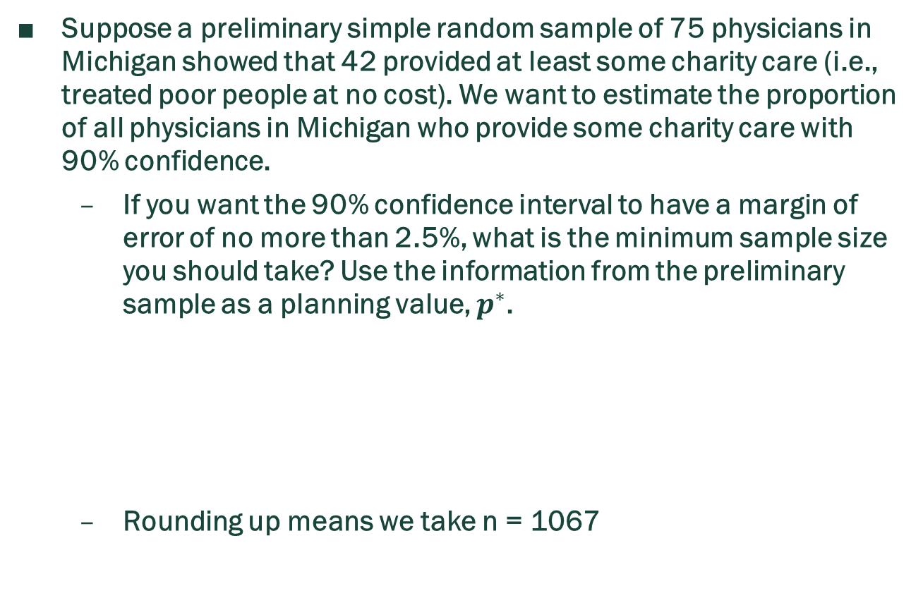
Self-read Example: Charity Care (1)
Suppose a preliminary simple random sample of 75 physicians in Michigan showed that 42 provided at least some charity care (i.e., treated poor people at no cost). We want to estimate the proportion of all physicians in Michigan who provide some charity care with 90% confidence.
  If you want the 90% confidence interval to have a margin of error of no more than 2.5%, what is the minimum sample size you should take? Use the information from the preliminary sample as a planning value, $p^{∗}$.
  Rounding up means we take n = 1067

Slide 42

Self-read Example: Charity care (2)
Suppose you had no preliminary information about the proportion of physicians who provide some charity care, but still want the 90% confidence interval to have a margin of error of no more than 2.5%. What is the minimum sample size we need? Why is it better to use a pilot sample where possible?

Slide 43
Review Question
Suppose a new, larger sample of physicians is selected and we calculate a standard error for the sample proportion to be 1.52%. What is the correct interpretation of this standard error?
  (i) In repeated samples of this size, we expect the sample proportion to be within 1.52% of the true population proportion, on average.
  (ii) The margin of error for the new confidence interval is 1.52%.
  (iii) If we take repeated samples, 90% of the sample proportions will be within 1.52% of the upper and lower bounds of our calculated confidence interval.
  (iv) Our confidence interval will include the true population proportion 1.52% of the time.

Slide 44
Hypothesis Tests For a Single Proportion
Recall the Basic Steps in Any Hypothesis Test
Determine appropriate null and alternative hypotheses.
Check assumptions for performing the test.
Calculate the test statistic and determine the p-value.
Evaluate the p-value and the compatibility of the null model.
If necessary, make a recommendation in the context of the problem.

Slide 45
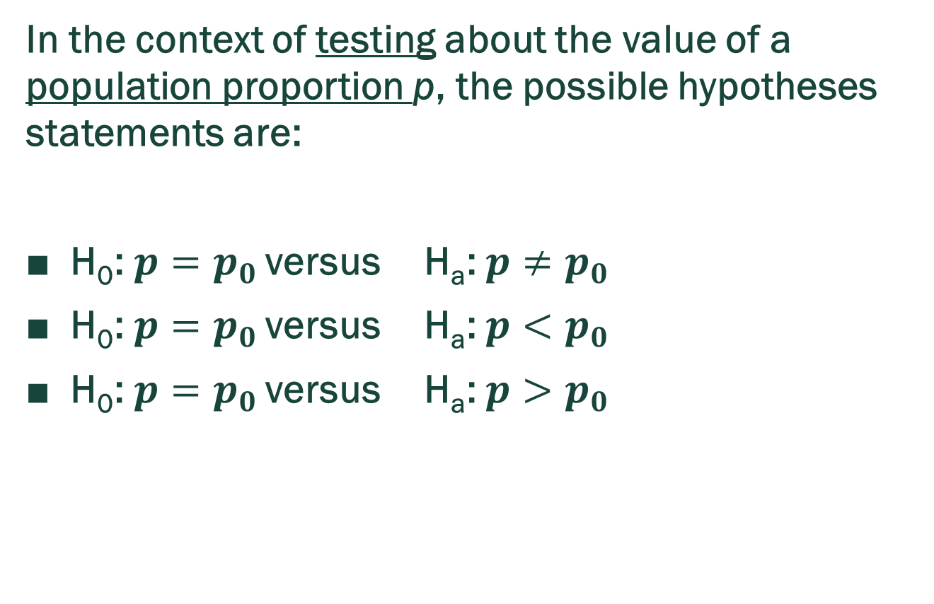
Testing Hypotheses About a Population Proportion
In the context of testing about the value of a population proportion p, the possible hypotheses statements are:
H₀: $p=p_{0}$ versus H_{a}: $p≠p_{0}$
H₀: $p=p_{0}$ versus H_{a}: $p<p_{0}$
H₀: $p=p_{0}$ versus H_{a}: $p>p_{0}$

Slide 46
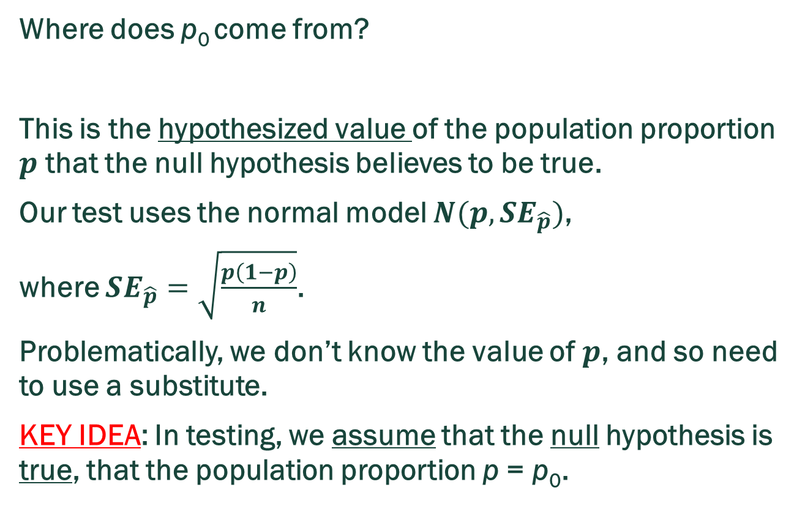
Where does $p_{0}$ come from?
Where does p₀ come from?
This is the hypothesized value of the population proportion $p$ that the null hypothesis believes to be true.
Our test uses the normal model $N(p,SE_{\hat{p}})$,
where $SE_{\hat{p}}=\sqrt{\frac{p\left(1−p\right)}{n}}$.
Problematically, we don’t know the value of $p$, and so need to use a substitute.
KEY IDEA: In testing, we assume that the null hypothesis is true, that the population proportion p = p₀.

Slide 47
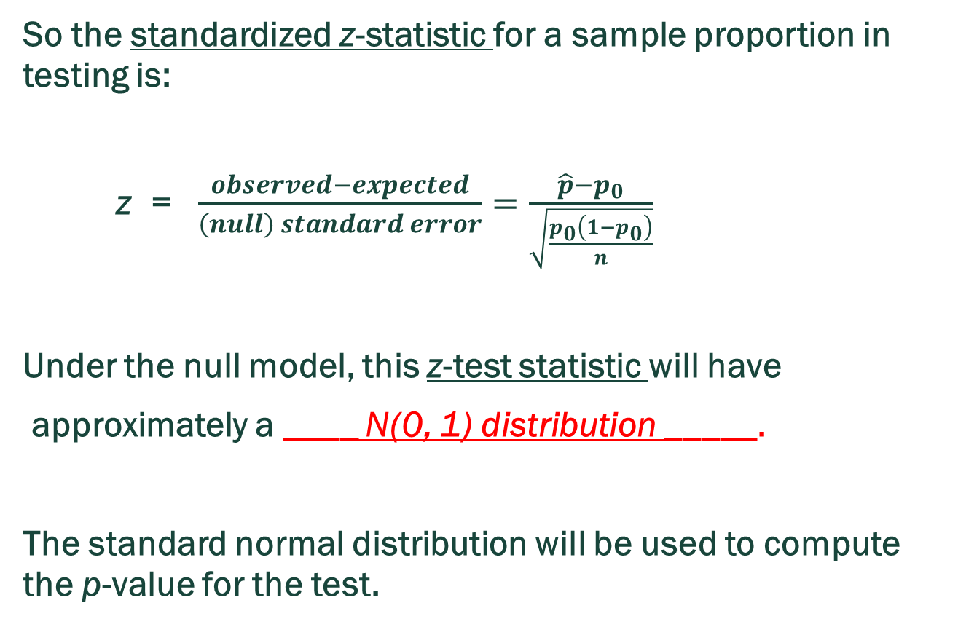
Where does $p_{0}$ come from?
So the standardized z-statistic for a sample proportion in testing is:
z = $\frac{observed−expected}{\left(null\right) standard error}=\frac{\hat{p}−p_{0}}{\sqrt{\frac{p_{0}\left(1−p_{0}\right)}{n}}}$
Under the null model, this z-test statistic will have
approximately a ____ N(0, 1) distribution _____.
The standard normal distribution will be used to compute the p­-value for the test.

Slide 48
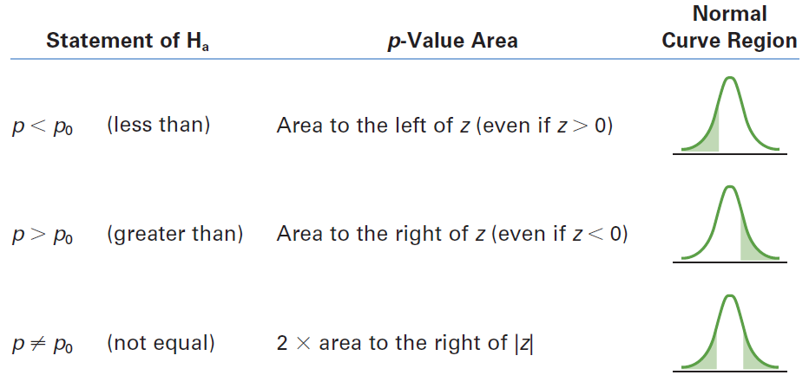
Computing the P – value

Slide 49
Example 1 SIMILAR TO HW6
Suppose a national survey conducted among a simple random sample of 1100 adults show that 54% of Americans think the Civil War is still relevant to American politics and political life. Round all results to four decimal places.
(1) What are the hypotheses for conducting a hypothesis test to determine if these data provide strong evidence that the majority of the Americas think the Civil War is still relevant.
A. H₀: p = 0.50 versus H_{a}: p < 0.50
B. H₀: p = 0.50 versus H_{a}: p > 0.50
C. H₀: p = 0.50 versus H_{a}: p ≠ 0.50

Slide 50
Example 1 SIMILAR TO HW6 PROBLEM 6
(2) Calculate the test statistic for this hypothesis test.
(3) Calculate the p – value for this hypothesis test.
(4) What is your conclusion?

Slide 51
Example 2 SIMILAR TO HW6
Among a simple random sample of 275 American adults who do not have a four-year college degree and are not currently enrolled in school, 44% said they decided not to go to college because they could not afford school. Round answers to 4 decimal places.
(1) A newspaper states that only a minority of the Americans who decide not to go to college do so because they cannot afford it and uses the point estimate from this survey as evidence. What are the correct hypotheses for conducting a hypothesis test to determine if these data provide strong evidence supporting this statement?
A. H₀: p = 0.50 versus H_{a}: p < 0.50
B. H₀: p = 0.50 versus H_{a}: p > 0.50
C. H₀: p = 0.50 versus H_{a}: p ≠ 0.50

Slide 52
Example 2 SIMILAR TO HW6
(2) Calculate the test statistic for this hypothesis test.
(3) Calculate the p – value for this hypothesis test.
(4) What is your conclusion?

Slide 53
Self-read Example: Left-handed Artists
About 10% of the human population is left-handed. Suppose that a researcher speculates that artists are more likely to be left-handed than are other people in the general population.
The researcher surveys a random sample of 150 artists and finds that 18 of them are left-handed.
Perform the test.

Slide 54
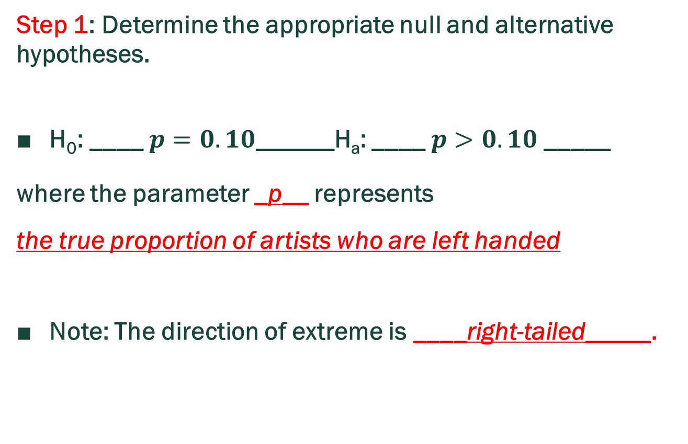
Self-read Example: Left-handed Artists
Step 1: Determine the appropriate null and alternative hypotheses.
H₀: ____$p=0.10$______H_{a}: ____$p>0.10$ _____
where the parameter _p__ represents
the true proportion of artists who are left handed
Note: The direction of extreme is ____right-tailed_____.

Slide 55

Self-read Example: Left-handed Artists
Step 2: Check the success-failure assumption for performing the test.
Condition 1: The data are assumed to be a random sample.
Condition 2: Check if np₀ ≥ 10 and n(1 – p₀) ≥ 10.
Is it appropriate to use a normal model for this test? Answer: Yes, because all the conditions are satisfied.

Slide 56

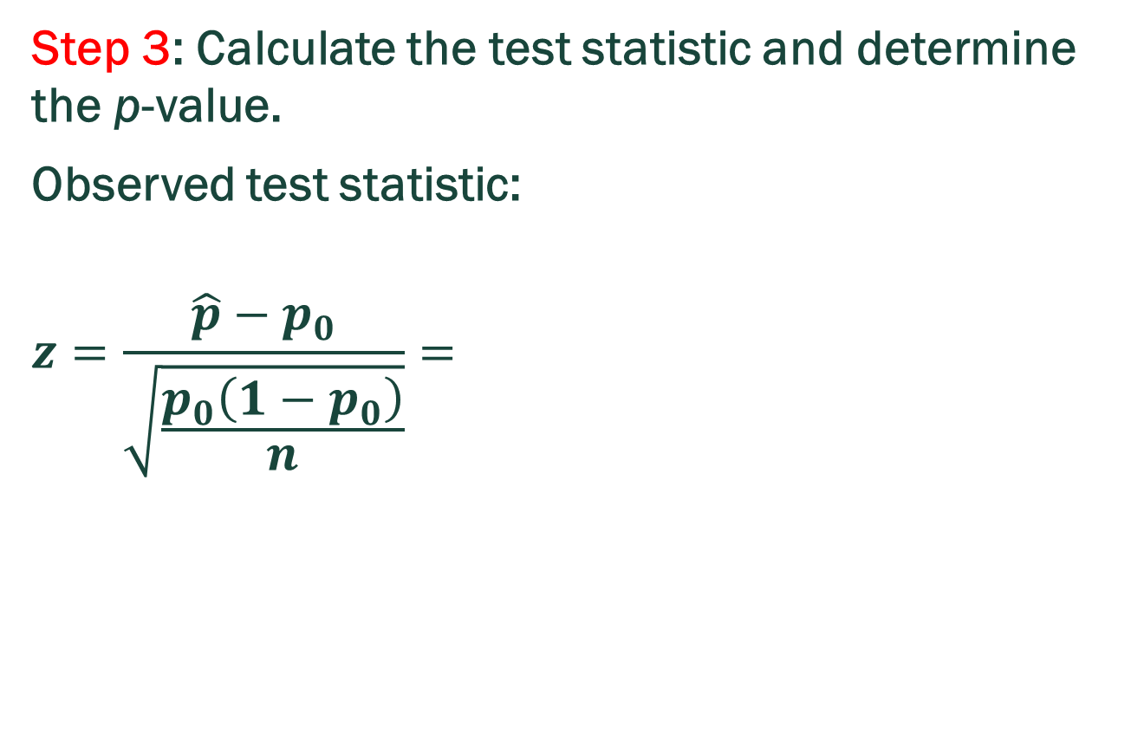
Self-read Example: Left-handed Artists
Step 3: Calculate the test statistic and determine the p-value.
Observed test statistic:
$$z=\frac{\hat{p}−p_{0}}{\sqrt{\frac{p_{0}\left(1−p_{0}\right)}{n}}}=$$

Slide 57
Self-read Example: Left-handed Artists
Step 3: Calculate the test statistic and determine the p-value.
The p-value is the probability of getting a test statistic as extreme or more extreme than the observed test statistic value, under the null model. Since we have a one-sided test to the right, toward the larger values …
p-value = probability of getting a z test statistic as large or larger than observed, assuming the null hypothesis is true.

Slide 58
Self-read Example: Left-handed Artists
Step 3: Calculate the test statistic and determine the p-value.
P – value = normalcdf(0.8165, 10^10, 0, 1) = 0.2071

Slide 59
Self-read Example: Left-handed Artists
Step 4: Evaluate the p-value and the compatibility of the null model with observed results.
Answer: With a p – value of 0.2071, we have little evidence that the null model is not a good fit for our observed results.

Slide 60
Self-read Example: Households Without Children
The US Census reports that 48% of households have no children. A random sample of 500 households was taken to assess if the population proportion has changed from 0.48. Of the 500 households, 220 had no children.
Step 1: Determine the appropriate null and alternative hypotheses.
H₀: p = 0.48 H_{a}: p ≠ 0.48
where the parameter p represents the population proportion of all households today that have no children.
Note: The direction of extreme is two-sided.

Slide 61
Self-read Example: Households Without Children
Step 2: Check the success-failure assumption for performing the test.
Condition 1: The data are assumed to be a random sample.
Condition 2: Check if np₀ ≥ 10 and n(1 – p₀) ≥ 10.
Is it appropriate to use a normal model for this test? Answer: Yes, because all the conditions are satisfied.

Slide 62

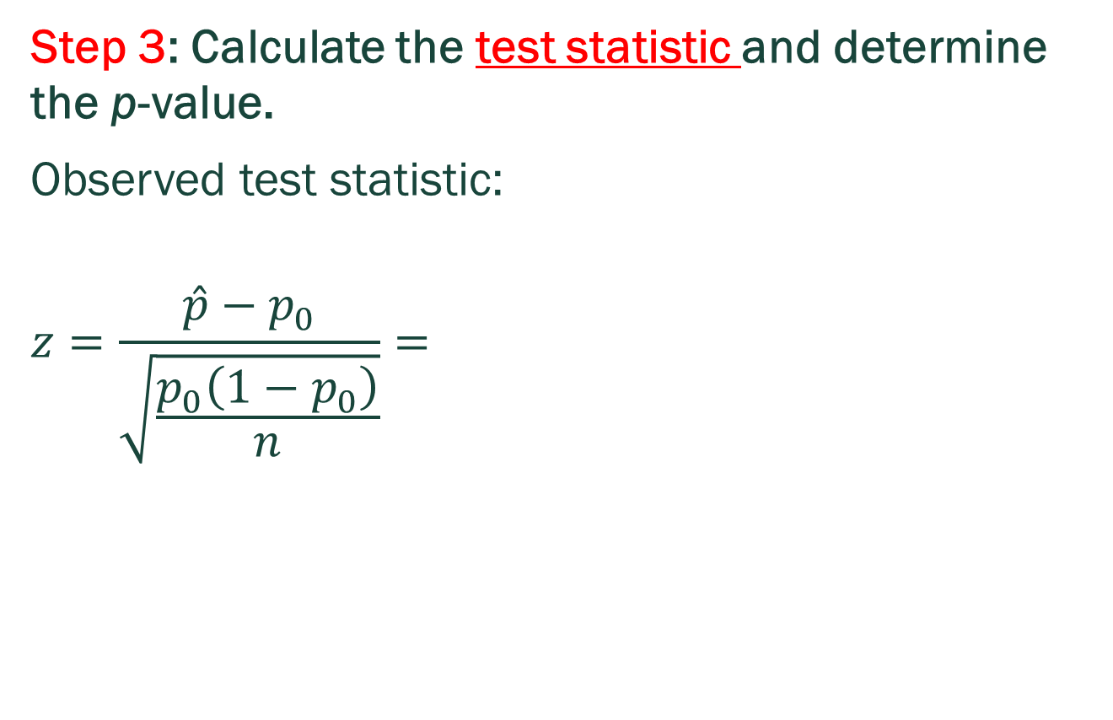
Self-read Example: Households Without Children
Step 3: Calculate the test statistic and determine the p-value.
Observed test statistic:
$$z=\frac{\hat{p}−p_{0}}{\sqrt{\frac{p_{0}\left(1−p_{0}\right)}{n}}}=$$

Slide 63
Self-read Example: Households Without Children
Step 3: Calculate the test statistic and determine the p-value.
P – value = 2*normalcdf(-10^10, -1.790, 0, 1) = 0.07345
The p-value is the probability of getting a test statistic as extreme or more extreme than the observed test statistic value, using the null hypothesis model. Since we have a two-tailed test, both large and small values are “extreme”.

Slide 64
Self-read Example: Households Without Children
Step 4: Evaluate the p-value and the compatibility of the null model with observed results.
Answer: With a p – value of 0.0735, we have some evidence that the null model is not a good fit for our observed results.

Slide 65
Thinking Challenge 1
IN THE 1980s IT WAS GENERALLY BELIEVED THAT CONGENITAL ABNORMALITIES AFFECTED ABOUT 5% OF THE NATION’S CHILDREN. SOME PEOPLE BELIEVE THAT THE INCREASE IN THE NUMBER OF CHEMICALS IN THE ENVIRONMENT HAS LED TO AN INCREASE IN THE INCIDENCE OF ABNORMALITIES. A RECENT STUDY EXAMINED 384 CHILDREN AND FOUND THAT 46 OF THEM SHOWED SIGNS OF AN ABNORMALITY. IS THIS STRONG EVIDENCE THAT THE RISK HAS INCREASED? ( WE CONSIDER A P – VALUE OF AROUND 5% TO REPRESENT STRONG EVIDENCE.)
(A) WRITE APPROPRIATE HYPOTHESES.
(B) CHECK THE NECESSARY ASSUMPTIONS.
(C) PERFORM THE MECHANICS OF THE TEST. WHAT IS THE P – VALUE?
(D) EXPLAIN CAREFULLY WHAT THE P – VALUE MEANS IN THIS CONTEXT.
(E) WHAT’S YOUR CONCLUSION?

Slide 66
Solution To Thinking Challenge 1 Using TI – 84 Calculator
Press [STAT].
Select [TESTS].
Choose: 1-PropZTest.
Input the following:
  p: .05
  x: 46
  n: 384
Prop: Indicate what kind of test you want: right-tail; left-tail; two-tail;
Choose Calculate and press [ENTER].

Slide 67
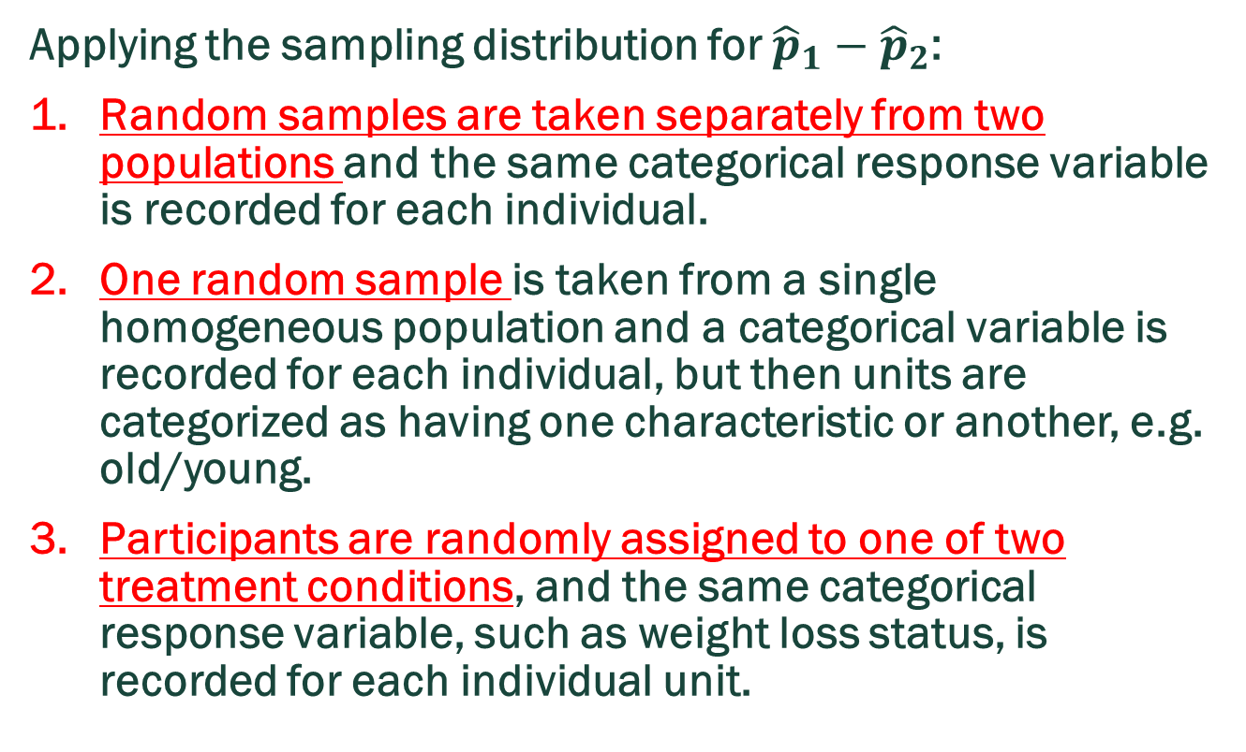
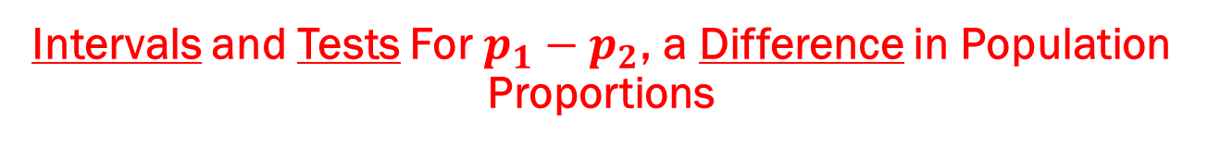
Intervals and Tests For $p_{1}−p_{2}$, a Difference in Population Proportions
Applying the sampling distribution for ${\hat{p}}_{1}−{\hat{p}}_{2}$:
Random samples are taken separately from two populations and the same categorical response variable is recorded for each individual.
One random sample is taken from a single homogeneous population and a categorical variable is recorded for each individual, but then units are categorized as having one characteristic or another, e.g. old/young.
Participants are randomly assigned to one of two treatment conditions, and the same categorical response variable, such as weight loss status, is recorded for each individual unit.

Slide 68
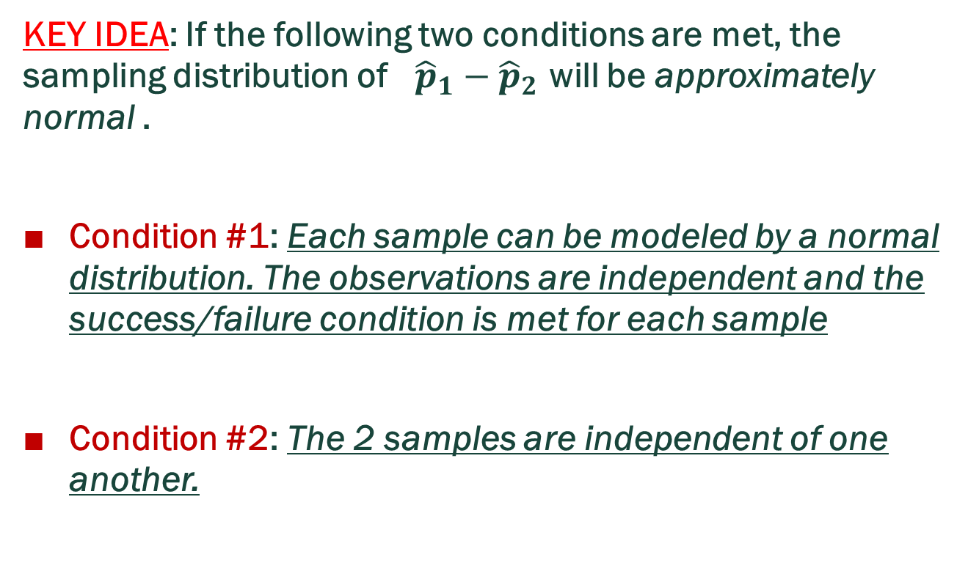
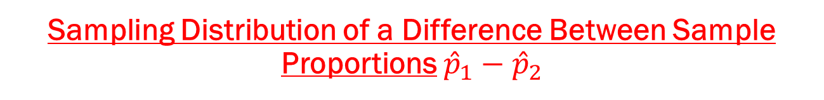
Sampling Distribution of a Difference Between Sample Proportions ${\hat{p}}_{1}−{\hat{p}}_{2}$
KEY IDEA: If the following two conditions are met, the sampling distribution of ${\hat{p}}_{1}−{\hat{p}}_{2}$ will be approximately normal .
Condition #1: Each sample can be modeled by a normal distribution. The observations are independent and the success/failure condition is met for each sample
Condition #2: The 2 samples are independent of one another.

Slide 69
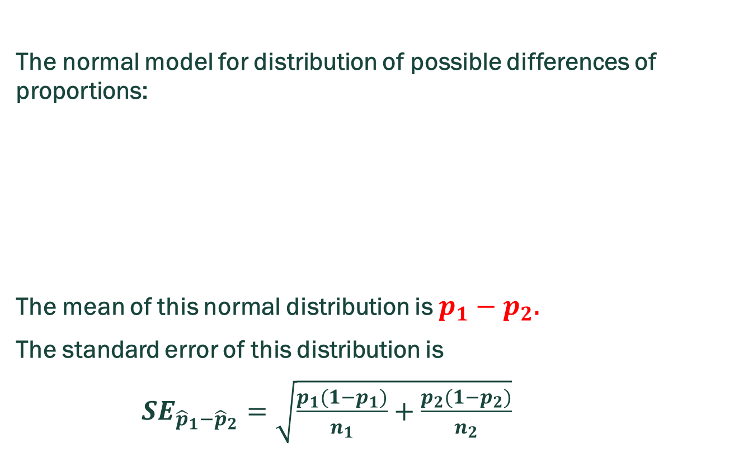
Sampling Distribution of a Sample Proportion ${\hat{p}}_{1}−{\hat{p}}_{2}$
The normal model for distribution of possible differences of proportions:
The mean of this normal distribution is $p_{1}−p_{2}\text{.}$
The standard error of this distribution is
$SE_{{\hat{p}}_{1}−{\hat{p}}_{2}}=\sqrt{\frac{p_{1}(1−p_{1})}{n_{1}}+\frac{p_{2}(1−p_{2})}{n_{2}}}$

Slide 70
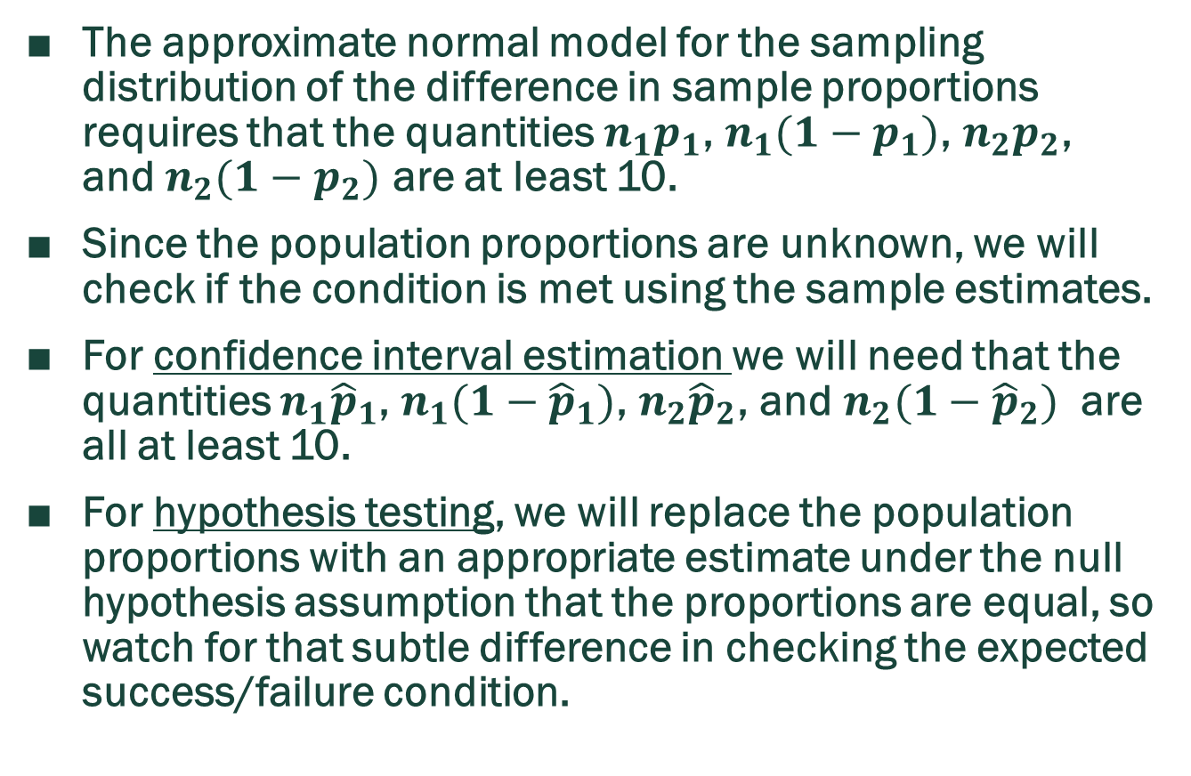
Checking Success/Failure Condition
The approximate normal model for the sampling distribution of the difference in sample proportions requires that the quantities $n_{1}p_{1}$, $n_{1}(1−p_{1})$, $n_{2}p_{2}$, and $n_{2}(1−p_{2})$ are at least 10.
Since the population proportions are unknown, we will check if the condition is met using the sample estimates.
For confidence interval estimation we will need that the quantities $n_{1}{\hat{p}}_{1}$, $n_{1}(1−{\hat{p}}_{1})$, $n_{2}{\hat{p}}_{2}$, and $n_{2}(1−{\hat{p}}_{2})$ are all at least 10.
For hypothesis testing, we will replace the population proportions with an appropriate estimate under the null hypothesis assumption that the proportions are equal, so watch for that subtle difference in checking the expected success/failure condition.

Slide 71
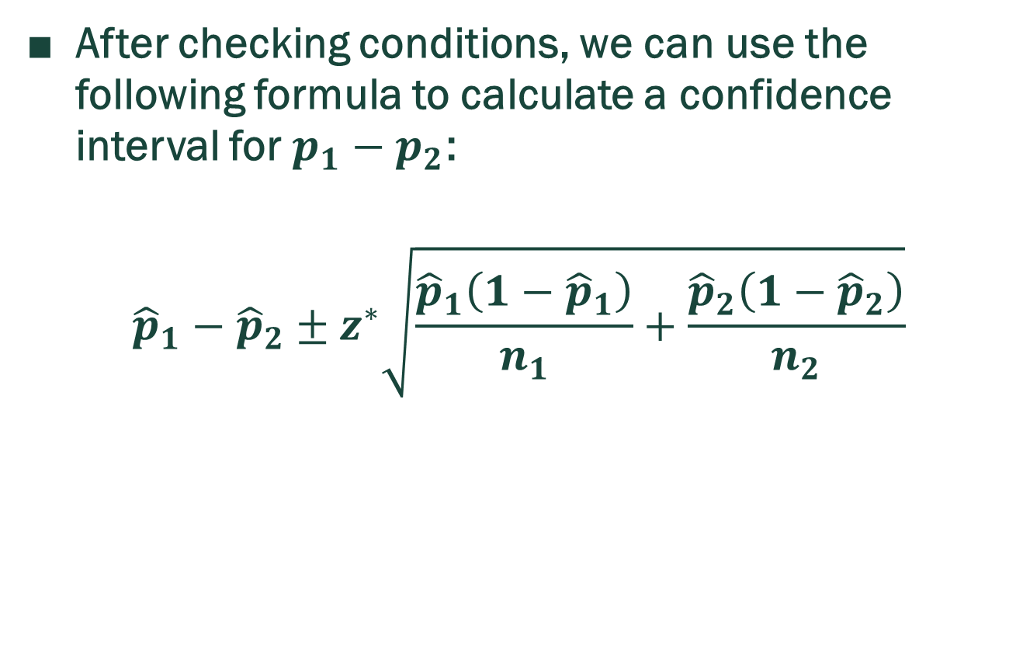
Confidence Intervals For $p_{1}−p_{2}$
After checking conditions, we can use the following formula to calculate a confidence interval for $p_{1}−p_{2}$:
$${\hat{p}}_{1}−{\hat{p}}_{2}±z^{∗}\sqrt{\frac{{\hat{p}}_{1}\left(1−{\hat{p}}_{1}\right)}{n_{1}}+\frac{{\hat{p}}_{2}\left(1−{\hat{p}}_{2}\right)}{n_{2}}}$$

Slide 72
Example: SIMILAR HW7
According to a report on sleep deprivation by the Centers for Disease Control and Prevention, the proportion of California residents who reported insufficient rest or sleep during each of the preceding 30 days is 8%, while this proportion is 8.8% for Oregon residents. These data are based on simple random samples of 11,545 California and 4,691 Oregon residents.
Calculate a 95% confidence interval for the difference between the proportions of Californians and Oregonians who are sleep deprived and interpret it in context of the data.

Slide 73
Example: SIMILAR HW7
Solution

Slide 74
Self-read Example: Market Research
Companies spend hundreds of billions of dollars in advertising every year. Suppose an advertising company is conducting research to evaluate the effectiveness of a client’s new advertising campaign.
Before the new campaign begins, a telephone survey of 550 households in the test market area showed 68 households are “aware” of the client’s product. The new campaign is then initiated with TV, radio, and newspaper advertisements running for three weeks.
A survey conducted immediately after the new campaign showed 151 of 700 households are “aware” of the client’s product.

Slide 75
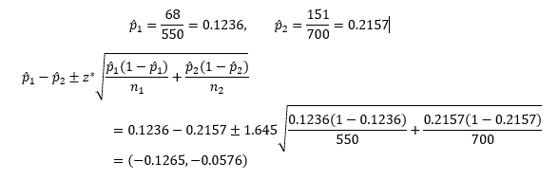
Self-read Example: Market Research
Compute the 90% confidence interval for the difference in the proportion of households before and after the campaign who are “aware” of the client’s product.

Slide 76
Self-read Example: Market Research
(b) How do we interpret this interval?
INTERPRETATION: We are 90% confident that the proportion of households who are aware of the product after the campaign increased somewhere in the range from 5.76% up to 12.65%
(c) How do we interpret the level of this interval?
ANSWER: 90% of intervals we construct this way will contain the true change in the proportion of households aware of the product.

Slide 77
Self-read Example: Market Research
(d) The client will only expand the campaign beyond the test market if they can be confident that there is at least a 10% increase in the percentage of household awareness of their product. Based on the confidence interval you calculated, should the client expand the campaign? Why or why not?
ANSWER: No. While 10% is in our interval, there are values in the interval that are less than 10%. Since all the values in the interval are plausible values for the true difference in proportions, we cannot be confident that the increase is at least 10%.

Slide 78
Example: Solution Using TI – 84 Calculator
There has been debate among doctors over whether surgery can prolong life among men suffering from prostrate cancer, a type of cancer that typically develops and spreads very slowly. In the summer of 2003, The New England Journal of Medicine published results of some Scandinavian research. Men diagnosed with prostrate cancer were randomly assigned to either undergo surgery or not. Among the 347 men who had surgery, 16 eventually died of prostrate cancer, compared with 31 of the 348 men who did not have surgery. Create a 95% confidence interval for the difference in rates of death for the two groups of men. ANS = (0.00579, 0.08015)

Slide 79
Example: Solution Using TI – 84 Calculator
Press [STAT].
Select [TESTS].
Choose B: 2-PropZInt….
Input the following:
  x1: 31
  n1: 348
  x2: 16
  n2: 347
  C-Level: 0.95
Choose Calculate and press [ENTER].

Slide 80
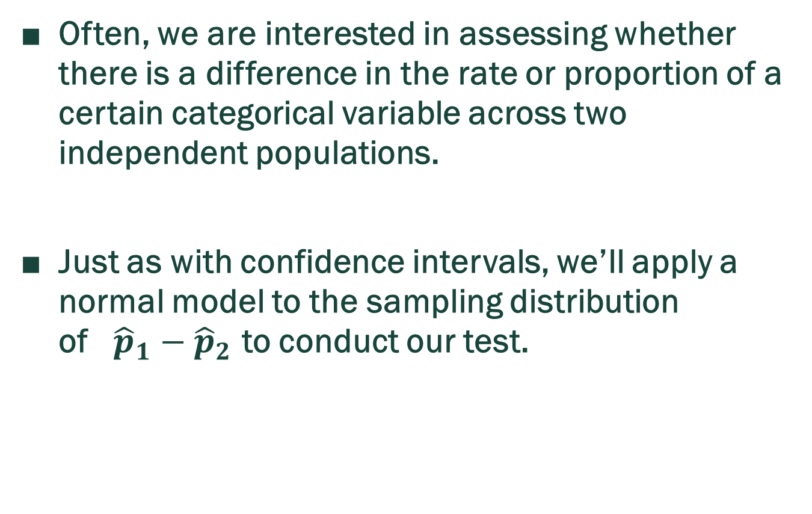
Hypothesis Testing When $H_{0}:p_{1}=p_{2}$
Often, we are interested in assessing whether there is a difference in the rate or proportion of a certain categorical variable across two independent populations.
Just as with confidence intervals, we’ll apply a normal model to the sampling distribution of ${\hat{p}}_{1}−{\hat{p}}_{2}$ to conduct our test.

Slide 81
Null And Alternative Hypotheses
Null hypotheses
H₀: p₁ – p₂ = 0 Versus
Alternative Hypotheses
  H_{a}: p₁ – p₂ < 0
H_{a}: p₁ – p₂ > 0
H_{a}: p₁ – p₂ ≠ 0

Slide 82
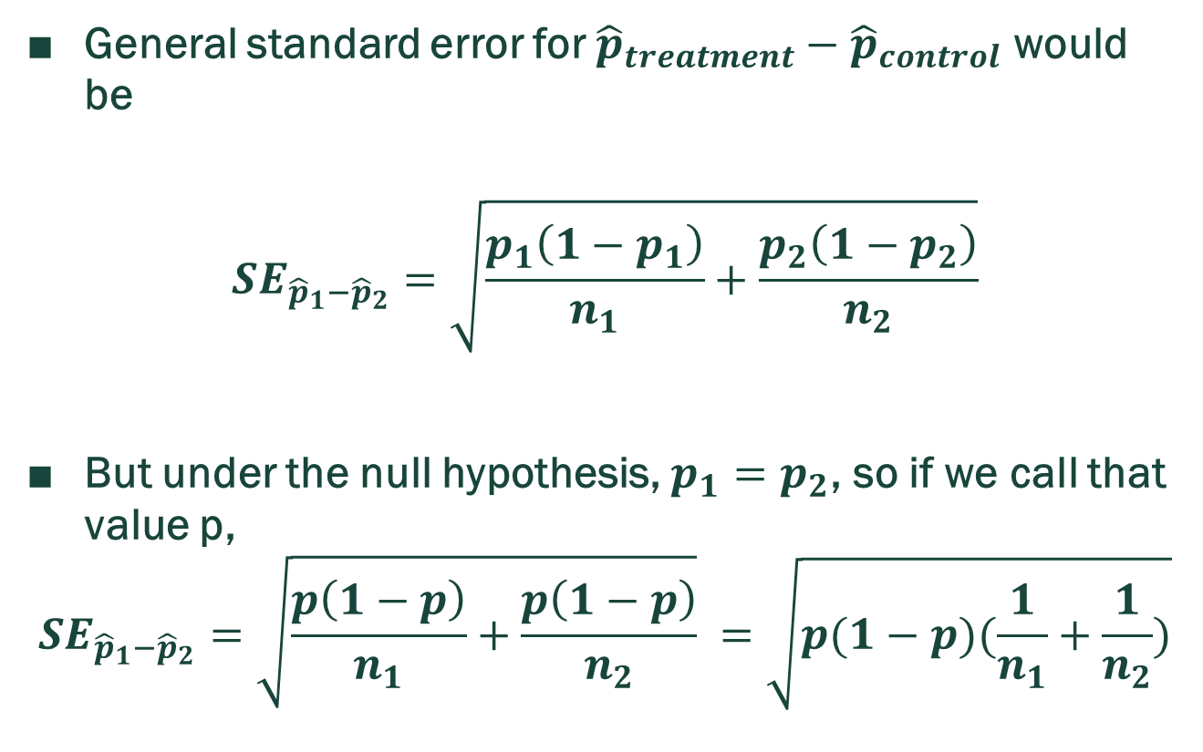

Computing the Standard Error $SE_{{\hat{p}}_{1}−{\hat{p}}_{2}}I$n Hypothesis Tests
General standard error for ${\hat{p}}_{treatment}−{\hat{p}}_{control}$ would be
$$SE_{{\hat{p}}_{1}−{\hat{p}}_{2}}=\sqrt{\frac{p_{1}\left(1−p_{1}\right)}{n_{1}}+\frac{p_{2}\left(1−p_{2}\right)}{n_{2}}}$$
But under the null hypothesis, $p_{1}=p_{2}$, so if we call that value p,
$$SE_{{\hat{p}}_{1}−{\hat{p}}_{2}}=\sqrt{\frac{p\left(1−p\right)}{n_{1}}+\frac{p\left(1−p\right)}{n_{2}}} =\sqrt{p(1−p)(\frac{1}{n_{1}}+\frac{1}{n_{2}})}$$

Slide 83
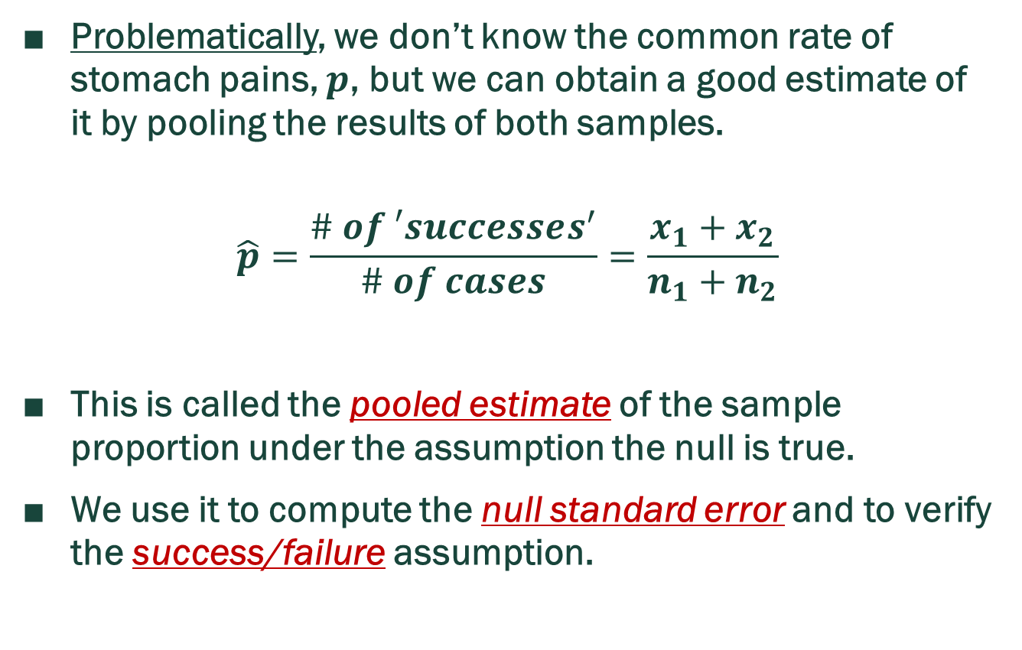
Pooled Estimate of p
Problematically, we don’t know the common rate of stomach pains, $p$, but we can obtain a good estimate of it by pooling the results of both samples.
$$\hat{p}=\frac{\# of ′successes^{′}}{\# of cases}=\frac{x_{1}+x_{2}}{n_{1}+n_{2}}$$
This is called the pooled estimate of the sample proportion under the assumption the null is true.
We use it to compute the null standard error and to verify the success/failure assumption.

Slide 84

Test Statistic
$z=\frac{{\hat{p}}_{1}−{\hat{p}}_{2}}{SE_{{\hat{p}}_{1}−{\hat{p}}_{2}}}$
where $SE_{{\hat{p}}_{1}−{\hat{p}}_{2}}=\sqrt{p(1−p)(\frac{1}{n_{1}}+\frac{1}{n_{2}})}$

Slide 85
P - value

Slide 86
Example 1: SIMILAR HW7
According to a report on sleep deprivation by the Centers for Disease Control and Prevention, the proportion of California residents who reported insufficient rest or sleep during each of the preceding 30 days is 8%, while this proportion is 8.8% for Oregon residents. These data are based on simple random samples of 11,545 California and 4,691 Oregon residents.
Conduct a hypothesis test to determine if these data provide strong evidence the rate of sleep deprivation is different for the two states.

Slide 87
Example 1: SIMILAR HW7
SOLUTION

Slide 88
Example 2: SIMILAR HW7
A news article reports that “Americans have differing views on two potentially inconvenient and invasive practices that airports could implement to uncover potential terrorist attacks.”
This news piece was based on a survey conducted among a random sample of 1,137 adults nationwide, interviewed by telephone November 7 – 10, 2010, where one of the questions on the survey was “Some airports are now using ‘full-body’ digital x-ray machines to electronically screen passengers in airport security lines. Do you think these new x-ray machines should or should not be used at airports?” Below is summary of responses based on party affiliation.

Slide 89
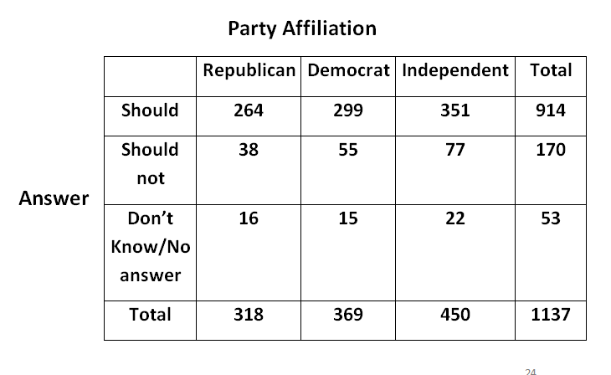
Example 2: SIMILAR HW7

Slide 90
Example 2: SIMILAR HW7
(1) What is the proportion of Republicans who think the full-body scans should be applied in airports?
(2) What is the proportion of Democrats who think the full-body scans should be applied in airports?

Slide 91
Example 2: SIMILAR HW7
(3) What are the correct hypotheses for a hypothesis test evaluating whether there is a difference in the proportion of Republicans and Democrats who think the full-body scans should be applied in airports? Assume that all relevant conditions are met.
(4) Calculate the pooled estimate of a proportion for this test.

Slide 92
Example 2: SIMILAR HW7
(5) Calculate the standard error for this test.
(6) Calculate the test statistic for this hypothesis test.

Slide 93
Example 2: SIMILAR HW7
(7) Calculate the p – value for this hypothesis test.
(8) What is your conclusion?

Slide 94
Using TI – PLUS 84 Calculator
Press STAT
Scroll to TESTS
Scroll to 2 - PropZTest
Press ENTER
Enter values for x1, n1, for population 1 and, x2, n2, for population 2.
Indicate what kind of test you want: right-tail; left-tail; two-tail;
Scroll to CALCULATE and press ENTER

Slide 95
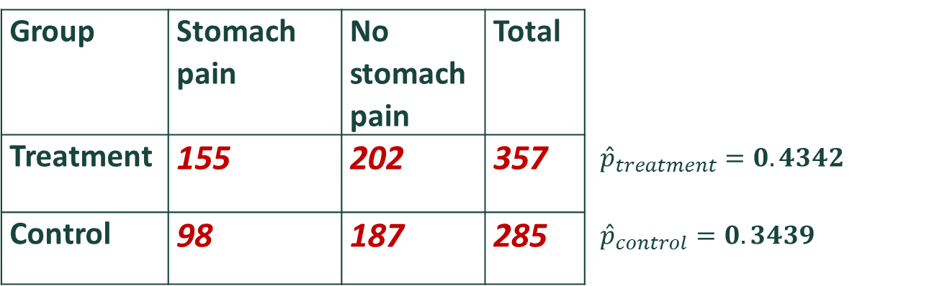
Self-read Example: Stomach Pains
In a randomized, controlled double-blind study of a new drug, there were 357 people in the treatment group and 285 in the control group. It was found that 155 people in the treatment group experienced stomach pains, whereas 98 people in the control group experienced stomach pains.
It’s helpful to organize the information using a table:
Group | Stomach pain | No stomach pain | Total
Treatment | 155 | 202 | 357 | ${\hat{p}}_{treatment}=0.4342$
Control | 98 | 187 | 285 | ${\hat{p}}_{control}=0.3439$

Slide 96
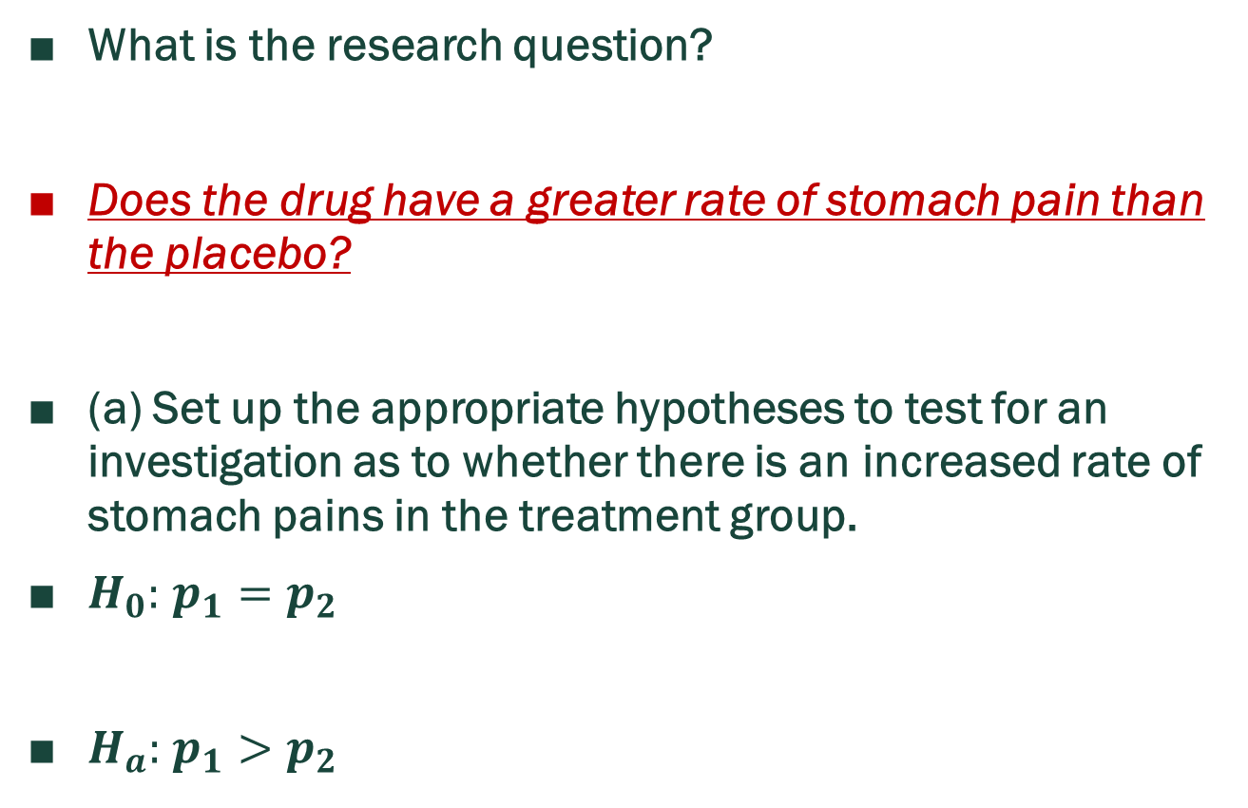
Self-read Example: Stomach Pains
What is the research question?
Does the drug have a greater rate of stomach pain than the placebo?
(a) Set up the appropriate hypotheses to test for an investigation as to whether there is an increased rate of stomach pains in the treatment group.
$H_{0}:$ $p_{1}=p_{2}$
$H_{a}:$ $p_{1}>p_{2}$

Slide 97
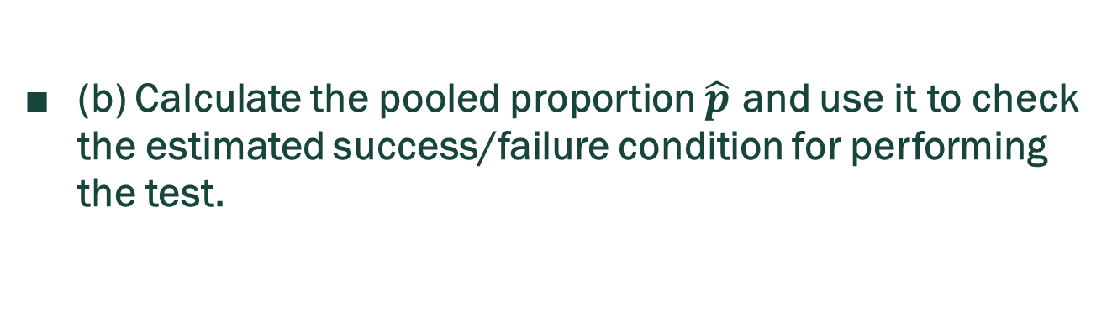
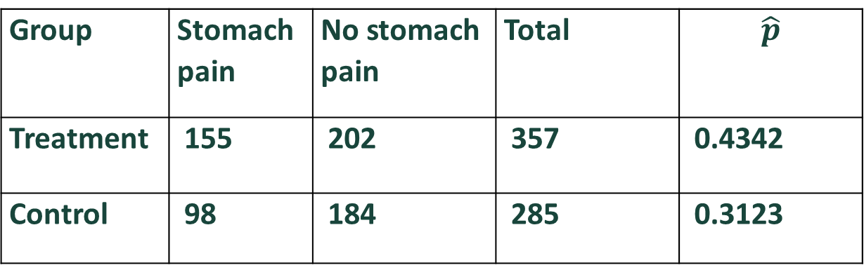
Self-read Example: Stomach Pains
Group | Stomach pain | No stomach pain | Total | $$\hat{p}$$
Treatment | 155 | 202 | 357 | 0.4342
Control | 98 | 184 | 285 | 0.3123
(b) Calculate the pooled proportion $\hat{p}$ and use it to check the estimated success/failure condition for performing the test.

Slide 98

Self-read Example: Stomach Pains
(b) Pooled proportion

Slide 99


Self-read Example: Stomach Pains
(c) Calculate the test statistic.
$z=\frac{{\hat{p}}_{1}−{\hat{p}}_{2}}{SE_{{\hat{p}}_{1}−{\hat{p}}_{2}}}$ where $SE_{{\hat{p}}_{1}−{\hat{p}}_{2}}=\sqrt{p(1−p)(\frac{1}{n_{1}}+\frac{1}{n_{2}})}$
Observed test statistic:

Slide 100
Self-read Example: Stomach Pains
(d) Calculate the p-value.
p-value:
P – value = normalcdf(2.3267, 10^10, 0, 1) = 0.00999

Slide 101
Self-read Example: Stomach Pains
(e) Evaluate the reasonableness of the null model.
With a p – value of 0.00999, we have very strong evidence that the null model is not a good fit for our observed results. The null model seems less reasonable in light of our observed data.

Slide 102

Self-read Example: Taking More Pictures With Cell
A study found that more than 75% of young adults use their cell phones for taking pictures at least 2 times per week and suggested that the proportion for young women is higher than for young men. A follow-up study was conducted to investigate this conjecture.
H₀: $p_{1}=p_{2}$ versus H_{a}: $p_{1}>p_{2}$
p₁ represents the population proportion of all young women 18-25 years old who report using their cell phone to take pictures at least 2 times per week, and
p₂ represents the population proportion of all young men 18-25 years old who report using their cell phone to take pictures at least 2 times per week.

Slide 103

Self-read Example: Taking More Pictures With Cell
We can assume these samples are independent random samples.
(2) Verify the remaining assumption necessary to conduct the Z test.

Slide 104

Self-read Example: Taking More Pictures With Cell
(2). Verify the remaining assumption necessary to conduct the Z test.

Slide 105

Self-read Example: Taking More Pictures With Cell
(3) Calculate the test statistic.

Slide 106
Self-read Example: Taking More Pictures With Cell
(4) Calculate the p – value.
P – value = normalcdl(1.907, 10^10, 0, 1) = 0.0283

Slide 107
Self-read Example: Taking More Pictures With Cell
Consider each of the following conclusions. Which among them is the least appropriate interpretation of the test results?
A. We interpret the test results to mean that the population proportion of all young women 18-25 years old who take pictures with their phone at least twice per week is about 5 percent higher than that of the population of all young men 18-25 years old.

Slide 108
Self-read Example: Taking More Pictures With Cell
Consider each of the following conclusions. Which among them is the least appropriate interpretation of the test results?
B. There is strong evidence a person’s gender influenced the rate at which they adopted the use of cell phones as cameras. Marketing firms should adapt their advertising plans to account for the findings that young adult women use cell phones in a manner different than their male counterparts.

Slide 109
Self-read Example: Taking More Pictures With Cell
Consider each of the following conclusions. Which among them is the least appropriate interpretation of the test results?
C. There is strong evidence a person’s gender influenced the rate at which they adopted the use of cell phones as cameras. Marketing firms might consider conducting more research to determine just how large the effect detected by this study might be.

Slide 110
Self-read Example: Revisiting the Weather
The National Weather Service maintains a weather station at the Lansing Municipal Airport. Data for the 700 days between January 1, 2015 and November 30, 2016 show the following results:
Let p₁ represent the proportion of weekdays with precipitation and let p₂ represent the proportion of weekend days with precipitation.
Day Type | Precipitation | No Precipitation | Total
Weekday | 265 | 235 | 500
Weekend | 119 | 81 | 200
Total | 384 | 316 | 700

Slide 111

Self-read Example: Revisiting the Weather
(1) State the hypotheses.
  H₀: $p_{1}=p_{2}$
  H_{A}: $p_{1}≠p_{2}$
We will consider the 700 days to be a random sample. Conduct the hypothesis test.

Slide 112

Self-read Example: Revisiting the Weather
(2) Pooled proportion and conditions check:

Slide 113

Self-read Example: Revisiting the Weather
(3) Test statistic, Z

Slide 114

Self-read Example: Revisiting the Weather
(4) Calculate the P – value

Slide 115
Self-read Example: Revisiting the Weather
What is your interpretation of the results?
ANSWER
Under the null model, we would expect to see a result as extreme as our observed result approximately 11.85% of the time. We have little evidence that the null model does not fit our observed results.

