Slide 1
STT 200 – Lecture 1, section 2,4
Recitation 10
(11/6/2012)
TA: Zhen (Alan) Zhang
zhangz19@stt.msu.edu
Office hour: (C500 WH) 1:45 – 2:45PM Tuesday
(office tel.: 432-3342)
Help-room: (A102 WH) 11:20AM-12:30PM, Monday, Friday
Class meet on Tuesday:
3:00 – 3:50PM A122 WH, Section 02
12:40 – 1:30PM A322 WH, Section 04

Slide 2
Overview
We will discuss following problems:
  Chapter 16 “Random Variables” (Page 426)
  # 3, 4, 8, 18, 28, 32
All recitation PowerPoint slides available at here

Slide 3
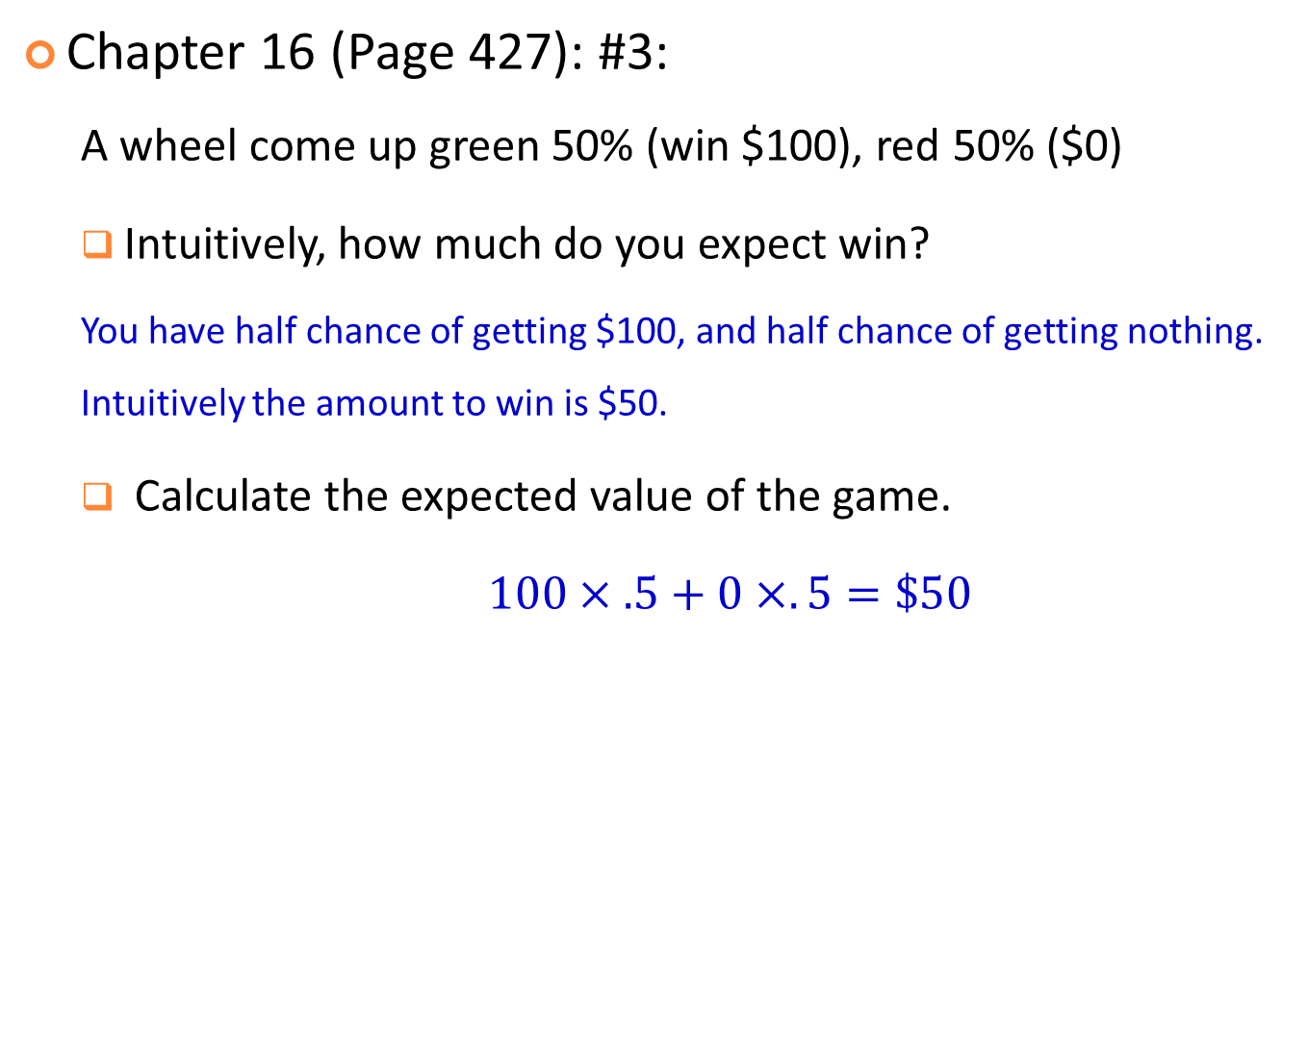
Chapter 16 (Page 427): #3:
  A wheel come up green 50% (win $100), red 50% ($0)
  Intuitively, how much do you expect win?
  You have half chance of getting $100, and half chance of getting nothing. Intuitively the amount to win is $50.
  Calculate the expected value of the game.
  $100×.5+0×. 5=\$50$

Slide 4

Chapter 16 (Page 427): #4:
  Stock market: gain $100 if goes up (75% chance),
  lose $200 if goes down (25% chance).
  Expected value of the option?
  $$100×.75−200×.25=\$25$$

Slide 5
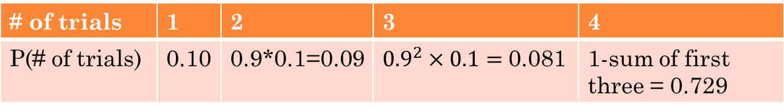
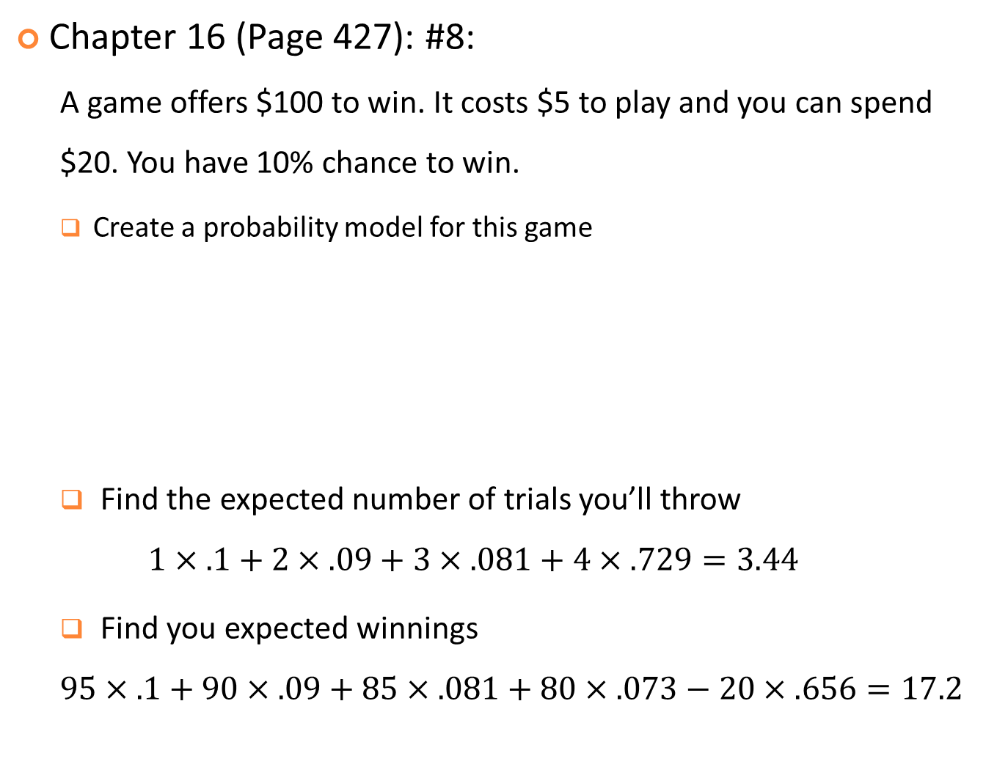
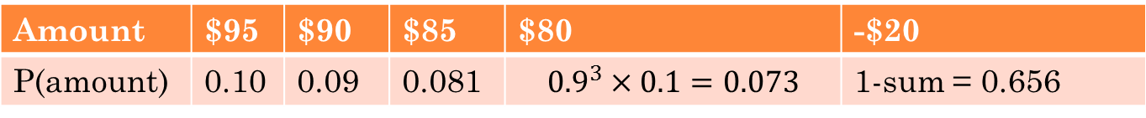
Chapter 16 (Page 427): #8:
  A game offers $100 to win. It costs $5 to play and you can spend $20. You have 10% chance to win.
  Create a probability model for this game
  Find the expected number of trials you’ll throw
  $$1×.1+2×.09+3×.081+4×.729=3.44$$
  Find you expected winnings
  $$95×.1+90×.09+85×.081+80×.073−20×.656=17.2$$
# of trials | 1 | 2 | 3 | 4
P(# of trials) | 0.10 | 0.9*0.1=0.09 | ${0.9}^{2}×0.1=$0.081 | 1-sum of first three = 0.729
Amount | $95 | $90 | $85 | $80 | -$20
P(amount) | 0.10 | 0.09 | 0.081 | $${0.9}^{3}×0.1=0.073$$ | 1-sum = 0.656
Q: Are you willing to play this game?

Slide 6
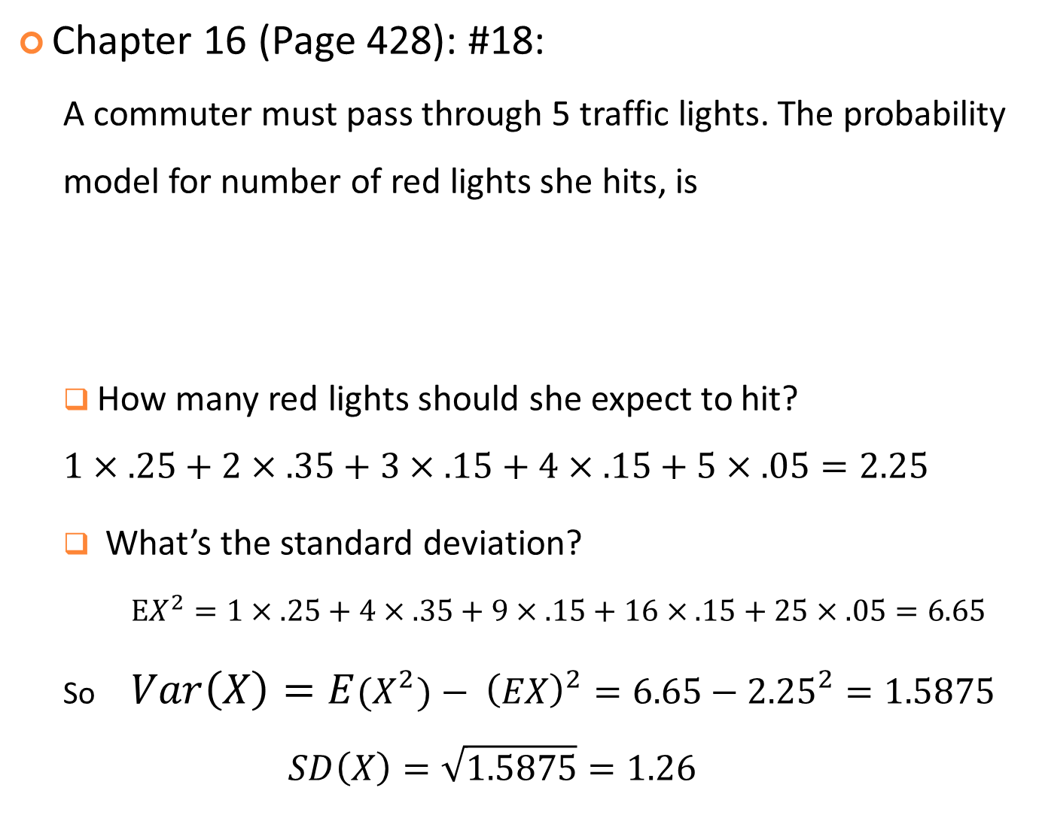
Chapter 16 (Page 428): #18:
  A commuter must pass through 5 traffic lights. The probability model for number of red lights she hits, is
  How many red lights should she expect to hit?
  $$1×.25+2×.35+3×.15+4×.15+5×.05=2.25$$
  What’s the standard deviation?
  $EX^{2}=1×.25+4×.35+9×.15+16×.15+25×.05=6.65$
  So $Var\left(X\right)=E{(X}^{2})− {\left(EX\right)}^{2}=6.65−{2.25}^{2}=1.5875$
  $$SD\left(X\right)=\sqrt{1.5875}=1.26$$
X = #of red | 0 | 1 | 2 | 3 | 4 | 5
P(X=x) | 0.05 | 0.25 | 0.35 | 0.15 | 0.15 | 0.05

Slide 7
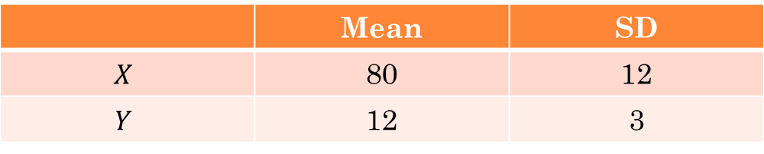

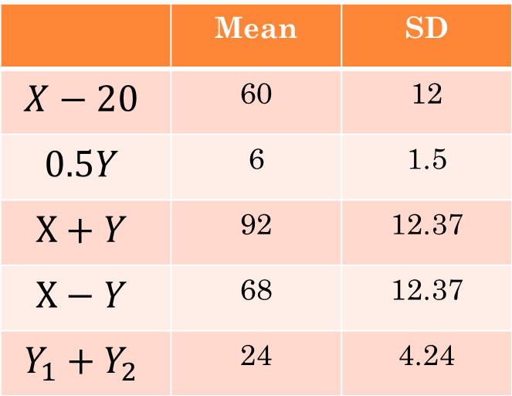
Chapter 16 (Page 429): #28:
  Given the means and SDs of two independent variables in the table, find Mean and SD for:
  $X−20$
  $0.5Y$
  $X+Y$
  $X−Y$
  $Y_{1}+Y_{2}$
 | Mean | SD
$$X$$ | 80 | 12
$$Y$$ | 12 | 3
 | Mean | SD
$$X−20$$ | 60 | 12
$$0.5Y$$ | 6 | 1.5
$$X+Y$$ | 92 | 12.37
$$X−Y$$ | 68 | 12.37
$$Y_{1}+Y_{2}$$ | 24 | 4.24

Slide 8
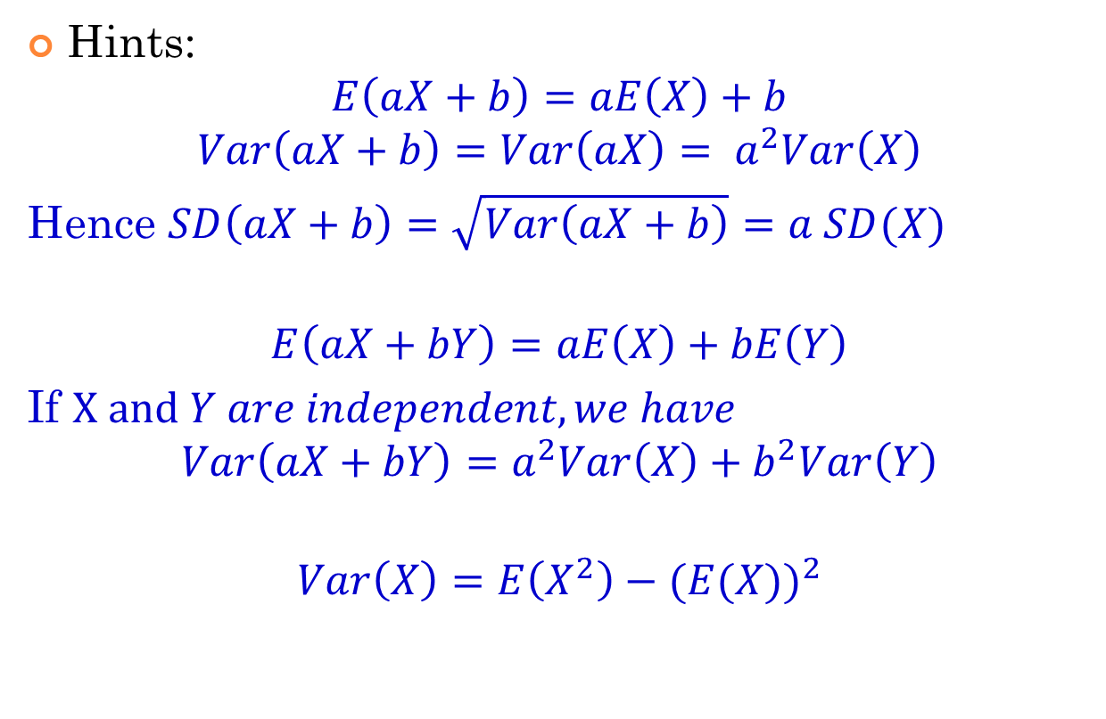
Hints:
$$E\left(aX+b\right)=aE\left(X\right)+b$$
$$Var\left(aX+b\right)=Var\left(aX\right)= a^{2}Var\left(X\right)$$
Hence $SD\left(aX+b\right)=\sqrt{Var\left(aX+b\right)}=a SD(X)$
$$E\left(aX+bY\right)=aE\left(X\right)+bE\left(Y\right)$$
If $X and Y are independent, we have$
$$Var\left(aX+bY\right)=a^{2}Var\left(X\right)+b^{2}Var\left(Y\right)$$
$$Var\left(X\right)=E\left(X^{2}\right)−{(E(X))}^{2}$$

Slide 9
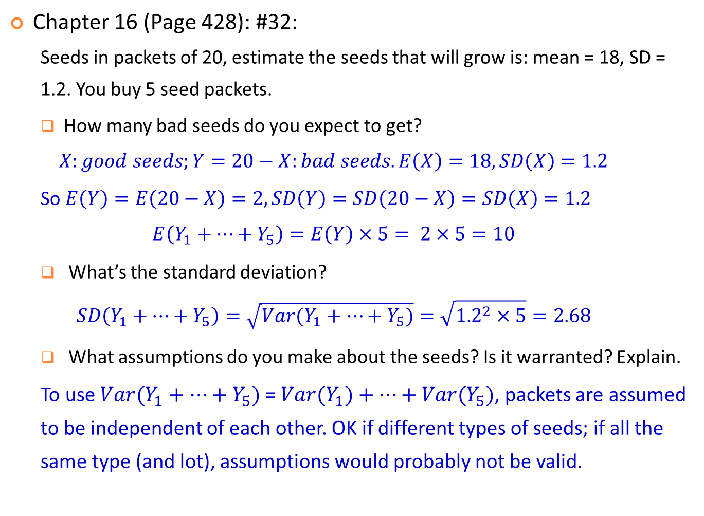
Chapter 16 (Page 428): #32:
  Seeds in packets of 20, estimate the seeds that will grow is: mean = 18, SD = 1.2. You buy 5 seed packets.
  How many bad seeds do you expect to get?
  $$X:good seeds;Y=20−X:bad seeds. E\left(X\right)=18, SD\left(X\right)=1.2$$
  So $E\left(Y\right)=E\left(20−X\right)=2, SD\left(Y\right)=SD\left(20−X\right)=SD\left(X\right)=1.2$
  $$E\left(Y_{1}+…+Y_{5}\right)=E\left(Y\right)×5= 2×5=10$$
  What’s the standard deviation?
  $$SD\left(Y_{1}+…+Y_{5}\right)=\sqrt{Var(Y_{1}+…+Y_{5})}=\sqrt{{1.2}^{2}×5}=2.68$$
  What assumptions do you make about the seeds? Is it warranted? Explain.
  To use $Var(Y_{1}+…+Y_{5})$ = $Var(Y_{1})+…+{Var(Y}_{5})$, packets are assumed to be independent of each other. OK if different types of seeds; if all the same type (and lot), assumptions would probably not be valid.

Slide 10
Thank you.

