Slide 1
STT 200 – Lecture 1, section 2,4 Recitation 11 (11/13/2012)
TA: Zhen (Alan) Zhang
zhangz19@stt.msu.edu
Office hour: (C500 WH) 1:45 – 2:45PM Tuesday
(office tel.: 432-3342)
Help-room: (A102 WH) 11:20AM-12:30PM, Monday, Friday
Class meet on Tuesday:
3:00 – 3:50PM A122 WH, Section 02
12:40 – 1:30PM A322 WH, Section 04

Slide 2
Overview
We will discuss following problems:
Chapter 17 “Probability Models” (Page 447)
# 2, 20, 22, 24
Complete review questions for Quiz 4:
CHAPTER 16: Nos. 1 - 8; 11 - 18; 23 - 32.
CHAPTER 17: Nos. 1 - 2; 9 - 12; 19 - 24.
I will answer questions on these if time permits.
All recitation PowerPoint slides available at here

Slide 3
Review
Geometric Model
$X$ = number of trials until the first success occurs.
$p$ = probability of success
$E\left(X\right)= \frac{1}{p}$, $SD\left(X\right)= \sqrt{\frac{1−p}{p^{2}}}$.
Binomial Model
$X$ = number of successes in $n$ independent trials.
$p$ = probability of success
$E\left(X\right)=np$, $SD\left(X\right)= \sqrt{np(1−p)}$
Both are based on Bernoulli trials.

Slide 4
Review
Check Bernoulli Trials
Two possible outcomes per trial (“Success” or “Failure”).
Constant Probability of success.
Trials are independent.
Check 10% condition when sampling without replacement.
(Page: 435) “Bernoulli trials must be independent. If that assumption is violated, it is still okay to proceed as long as the sample is smaller than 10% of the population. ”

Slide 5
Review
Difference between these and Normal Model
$X$ follows Bin($n, p$), then X can take integer values from $0$ to $n$. $X$ follows Geo($p$), then X can take any integer values from $1$. The two distributions are discrete. X follows N($μ, σ$), then X can take any values. Normal distribution is continuous.
In calculator, both binomcdf and normcdf return the left-tail-probability (cdf=cumulative distribution function) $P\left(X≤x\right)$. But since binomial variable can only take integer values, we have:
$P\left(X>x\right)=1−P\left(X≤x\right)=1−binomcdf\left(n,p,x\right)$, while
$P\left(X≥x\right)=1−P\left(X≤x−1\right)=1−binomcdf\left(n,p,x−1\right)$.
Clearly the two probabilities are not the same for $x=0,…,n$.
But for normal distribution, we have:
$P\left(X>x\right)=P\left(X≥x\right)=1−P\left(X≤x\right)=1−normcdf(−9^9,x,μ, σ)$.
Binompdf returns $P\left(X=x\right)$ for $X$ follows Bin($n, p$).
Since $P\left(X≤x\right)=P\left(X≤x−1\right)+P\left(X=x\right)$, we have
$$binomcdf\left(n,p,x\right)=binomcdf\left(n,p,x−1\right)+binompdf\left(n,p,x\right)$$
This is not the case for normcdf and normpdf.

Slide 6
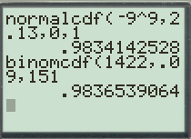
Review
Association between these and Normal Model
Nevertheless, binomcdf can be approximated by normcdf if the success/failure condition holds, i.e.: $np≥10$ and $nq=n\left(1−p\right)≥10$.
Specifically, for $X$ follows Bin($n, p$) with $np≥10$ and $nq=n\left(1−p\right)≥10$, to find $P(X≤x)$:
Find Z-score for $x$.
$z= \frac{x − μ}{σ}=\frac{x −np}{\sqrt{np(1−p)}}$
Then
$$P\left(X≤x\right)\text{ = }binomcdf\left(n,p,x\right)≈P\left(Z ≤z\right)= normcdf(−9^9,z,0,1)$$
And we can also find $P\left(Z ≤z\right)$ using standard normal table.
Example in Page 440:
$x=151$ from Bin($1422, 0.09$ )
Then $z=2.13$.

Slide 7
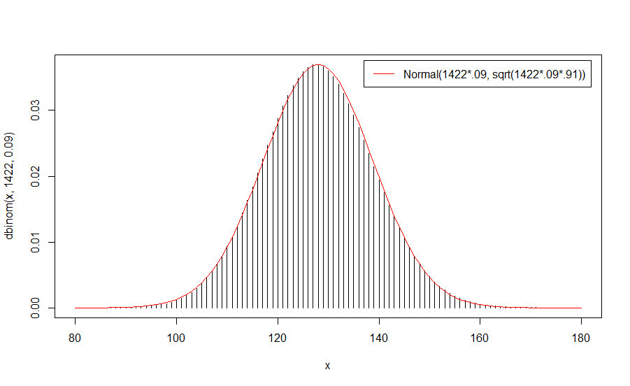
Review
Association between these and Normal Model

Slide 8
Are you ready to solve problems?

Slide 9
Chapter 17 (Page 447): #2:
Can we use Bernoulli models for the following? Explain:
Rolling 5 die and need to get at least two 6’s to win;
Yes. Outcomes are {getting a 6} and {not getting a 6};
We record the eye colors found in a group of 500 people;
No. More than two outcomes are possible.
A manufacturer recalls a doll because about 3% have buttons that are not properly attached. Customers returns 37 of these dolls. Is the manufacturer likely to find any dangerous buttons?
If the dolls were manufactured independently of each others, Yes.

Slide 10
Chapter 17 (Page 447): #2 (continued):
Can we use Bernoulli models for the following? Explain:
A city council of 11 Republicans and 8 Democrats picks a committee of 4 at random. What’s the probability they choose all Democrats?
No. The chance of a Democrat (or Republican) changes depending on who has already been picked.
74% of high-school students have cheated in a test at least once. You local high-school principal conducts a survey and gets responses that admit to cheating from 322 of the 481 students.
Yes, assuming responses (and cheating) are independent among the students.

Slide 11
Exercise:
Review question 2 above, and then similarly solve problem 1. Compare your results with answers given in the next slide.

Slide 12
Answers for the exercise:
1. Can we use models based on Bernoulli trials?
No. More than two outcomes are possible. [Unlike question a) in problem 2, where we only count 6’s. In that case we have only two outcomes, 6 or not 6, while here we have {1,2,3,4,5,6}, more than 2 outcomes.]
Yes, assuming the people are unrelated to each other.
No. The chance of a heart changes as cards are dealt.
No, 500 is more than 10% of 3000. [The 10% condition is violated in this situation (sampling without replacement)]
If packages in a case are independent of each other, yes;
Otherwise, no.

Slide 13
The remaining problems, 20, 22, 24 are dealing with arrows on bull’s-eyes

Slide 14
Chapter 17 (Page 448): #20:
An Olympic archer hits the bull’s-eye 80% of the time. Assume each shot is independent of the others. If she shoots 6 arrows, what is the probability of:
Her first bull’s-eye comes on the third arrow.
$$Y follows Geo\left(p=0.8\right), so P\left(Y=3\right)={.2}^{2}×.8=0.032$$
She missed the bull’s-eye at least once.
$$X the number of missed shots follows Bin\left(n=6,p=0.2\right), so$$
$$P\left(X≥1\right)=1−P\left(X≤0\right)=1−binomcdf\left(6,.2,0\right)=.738$$
Or simply, $1−P\left(hit all\right)=1− {.8}^{6}=0.738$.
Her first bull’s-eye comes on the forth or fifth arrow.
$$P\left(Y=4 or 5\right)=P\left(Y=4\right)+P\left(Y=5\right)={.2}^{3}×.8+{.2}^{4}×.8=.00768$$

Slide 15
Chapter 17 (Page 448): #20 (continued):
She gets exactly 4 bull’s-eye.
$$X the number of bull^{′}s\text{−}eye follows Bin\left(n=6,p=0.8\right),so$$
$$P\left(X=4\right)=binompdf\left(6,.8,4\right)=0.246$$
She gets at least 4 bull’s-eye.
$$P\left(X≥4\right)=1−P\left(X≤3\right)=1−binomcdf\left(6,.8,3\right)=0.901$$
She gets at most 4 bull’s-eye.
$$P\left(X≤4\right)=binomcdf\left(6,.8,4\right)=0.345$$

Slide 16
Chapter 17 (Page 448): #22:
An Olympic archer hits the bull’s-eye 80% of the time. Assume each shot is independent of the others. If she shoots 6 arrows, what is the probability of:
How many bull’s-eyes do you expect her to get?
$X$ the number of bull’s-eyes follows Bin($n=6, p=0.8$), so
$$E\left(X\right)=μ=np=4.8$$
With what standard deviation?
$$SD\left(X\right)=σ=\sqrt{np(1−p)}=0.98$$
If she keeps shooting arrows until she hits the bull’s-eye, how long do you expect it will take?
The number of trials $Y$follows Geo($p=0.8$), so $E\left(Y\right)=\frac{1}{p}=1.25$ shots.

Slide 17
Chapter 17 (Page 448): #24:
An Olympic archer hits the bull’s-eye 80% of the time. Assume each shot is independent of the others. Suppose she shoots 10 arrows.
Find the mean and standard deviation of the number of bull’s-eyes she may get.
$X$ the number of bull’s-eyes follows Bin($n=10, p=0.8$), so
$$E\left(X\right)=μ=np=8, SD\left(X\right)=σ=\sqrt{np(1−p)}=1.26$$
What’s the probability that she never misses?
$$P\left(never miss\right)=P\left(X=10\right)={0.8}^{10}=binompdf\left(10,.8,10\right)=0.107$$

Slide 18
Chapter 17 (Page 448): #24(continued):
What’s the probability that there are no more than 8 bull’s-eyes?
$$P\left(X≤8\right)=binomcdf\left(10,0.8,8\right)=0.624$$
What’s the probability that there are exactly 8 bull’s-eyes?
$P\left(X=8\right)=binompdf\left(10,0.8,8\right)=0.302$
What’s the probability that she hits the bull’s-eyes more often than she misses?
$$P\left(X>5\right)=1−P\left(X≤5\right)=1−binomcdf\left(10,0.8,5\right)=0.967$$

Slide 19
Exercise:
Review questions 20, 22 and 24 above, and then similarly solve problems 19, 21 and 23. Compare your results with answers given in the next slide.

Slide 20
Answers for the exercise:
19: P(Left Handed)=.13, n = 5
${.87}^{4}×.13= .0745$
$1−{.87}^{5}=0.502$
${.87}^{1}×.13{+.87}^{2}×.13=0.211$
$binompdf\left(5,.13,3\right)=.0166$
$1−binomcdf\left(5,.13,2\right)=.0179$
$binomcdf\left(5,.13,3\right)=.9987$
21:
$E\left(X\right)=np=5×.13=.65$
$SD\left(X\right)=\sqrt{np(1−p)}=.75$
$E\left(Y\right)=\frac{1}{.13}=7.69$ picks
23: P(Right Handed)=.87, n = 12
$E\left(X\right)=np=12×.87=10.44$, $SD\left(X\right)=\sqrt{np(1−p)}=1.16$
$1−{.87}^{12}=0.812$
$binomcdf\left(12,.87,10\right)=.475$
$binompdf\left(12,.87,6\right)=0.00193$
$1−binomcdf\left(12,.87,6\right)=.998$

Slide 21
Bonus Question:
Problem 23 in Chapter 16 (Page 428):
Play two games. P(win first game) = 0.4. If you win the first game, the chance you also win the second is 0.2. If you lose the first, the chance that you win the second is 0.3.
Are the two games independent?
Probability that you lose both games.
Probability that you win both games.
X be the number of games you win. Find the probability model.
Expected value and standard deviation of X?

Slide 22
Exercise:
Review the bonus questions above, and then similarly solve problems 24 in chapter 16.

Slide 23
Thank you.

