Slide 1
STT 200 – Lecture 1, section 2,4 Recitation 12 (11/20/2012)
TA: Zhen (Alan) Zhang
zhangz19@stt.msu.edu
Office hour: (C500 WH) 1:45 – 2:45PM Tuesday
(office tel.: 432-3342)
Help-room: (A102 WH) 11:20AM-12:30PM, Monday, Friday
Class meet on Tuesday:
3:00 – 3:50PM A122 WH, Section 02
12:40 – 1:30PM A322 WH, Section 04

Slide 2
Overview
We will discuss following problems:
Chapter 18 “Sampling Distribution Models” (Page 481)
# 18, 23, 24, 34, 37, 47, 48
All recitation PowerPoint slides available at here

Slide 3
Chapter 18 (Page 481): #18:
A national study found 44% college students engages in binge drinking.
Use the 68-95-99.7 rule to describe the sampling distribution model for the proportion of students in a randomly selected group of 200 college students who engage in binge drinking.
Do you think the appropriate conditions are met?
Conditions are met: It’s a random sample, with $np=88$ and $nq=200−88=112$. So SD = $\sqrt{\frac{p_{0}(1−p_{0})}{n}}$ = 0.035, mean = .44;

Slide 4
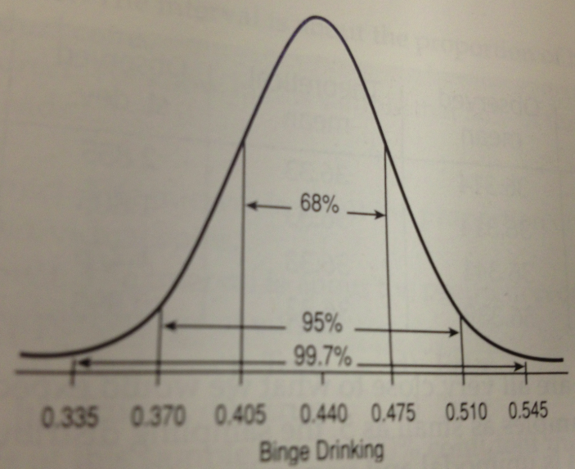
Chapter 18 (Page 481): #18:

Slide 5
Chapter 18 (Page 481): #23:
A random sample of 150 apples is selected and examined for bruise, discoloration, and other defects. The whole truckload will be rejected if more than 5% of the sample is unsatisfactory.
Suppose in fact 8% of the apples do not meet the desired standard.
What is the probability that the shipment will be accepted anyway?
Population proportion $p_{0}=0.08$ , sample size $n=150$,
Sample proportion $\hat{p} follows N\left(p_{0}, \sqrt{\frac{p_{0}(1−p_{0})}{n}})\right)$
$=N(0.08, 0.0222)$
to find $P(\hat{p}≤0.05)$,
normcdf(-9^9,0.05,0.08,0.0222) = 0.088.
Or use standardization approach as Page 466, textbook.

Slide 6
Chapter 18 (Page 481): #23 (continued):
to find $P(\hat{p}≤0.05)$, given$\hat{p} \text{f}ollows N(0.08, 0.0222)$
use standardization approach:
$P\left(\hat{p}≤0.05\right)=P\left(\frac{\hat{p}−0.08}{0.0222}≤\frac{0.05−0.08}{0.0222}\right)=P\left(z≤\frac{0.05−0.08}{0.0222}\right)=P\left(z≤-1.35\right)$
In the normal table, find left tail probability of -1.35.
If we only have positive values in the normal table, use the symmetric property of normal distribution, we know
$$P\left(z≤−1.35\right)=P\left(z>1.35\right)=1−P\left(z≤1.35\right)$$
So we find left tail probability of 1.35: .9115.
Then $P\left(z≤−1.35\right)=1 − .9115=0.0885$

Slide 7
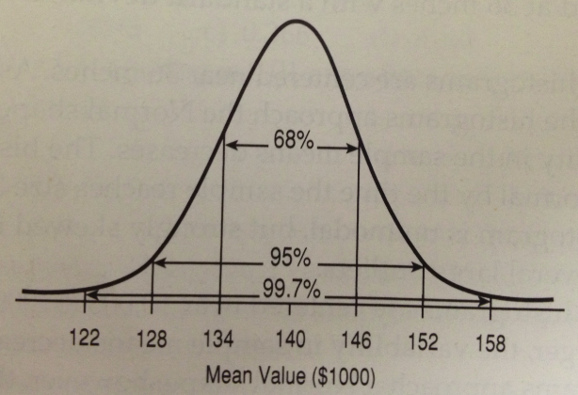
Chapter 18 (Page 483): #34:
Assessment records indicate that the values of homes is skewed right, with mean $140,000 and standard deviation $60,000.
We sample 100 homes at random. Use 68-95-99.7 rule, draw and label and appropriate sampling model for the mean value of the homes selected.
Mean = 140,000
SD = 6,000

Slide 8
Chapter 18 (Page 481): #24:
It’s believed that 4% of children have a gene that may be linked to juvenile diabetes. We hope to track 20 of these children for several years test 732 newborns for the presence of this gene.
What’s the probability that they find enough subjects for their study?
Population proportion $p_{0}=0.04$ , sample size $n=732$,
Sample proportion $\hat{p} follows N\left(p_{0}, \sqrt{\frac{p_{0}(1−p_{0})}{n}})\right)$
$=N(0.04, 0.007)$
to find $P\left(p≥\frac{20}{732}\right)=P\left(p≥0.0273\right)$,
normcdf($0.0273$, 9^9, 0.04,0.007) = 0.96493.
Or use standardization approach: z score for 0.0273 is -1.814, so
$$P\left(p≥0.0273\right)=P\left(z≥−1.814\right)=P\left(z≤1.814\right)=0.965$$

Slide 9
Use Normal tables or technology for the following.

Slide 10
Chapter 18 (Page 484): #47:
Carbon monoxide (CO) emissions for certain car vary with mean 2.9 g/mi and standard deviation 0.4 g/mi. A company has 80 of these cars. Let $\overline{y}$ be the mean CO level.
What is the approximate model for the distribution of $\overline{y}$ ? Explain.
N(2.9, 0.4/sqrt(80)) = N(2.9, 0.045)
Estimate the probability that $\overline{y}$ is between 3.0 and 3.1 g/mi.
Z scores (LTP) are 2.22(.9868) and 4.44 (1). So 1 - .9868 = 0.0132.
There is only a 5% chance that the mean CO level is greater than what value?
The LTP is 95% for 1.64 from the table, so $1.64×0.045+2.9=2.9738$

Slide 11
Chapter 18 (Page 483): #37:
Duration of human pregnancies follows Normal distribution with mean 266 days and standard deviation 16 days.
What percentage last between 270 and 280 days?
Z score for 270 and 280: 0.25 and 0.875 with LTP: .5987, .8106. So the answer is .8106 - .5987 = 0.2119 = 21.19%
At least how many days should the longest 25% last?
1 – 0.25 = 0.75 corresponds to 0.67 in the normal table. So the answer is $0.67×16+266=276.72$ days or more.
Let $\overline{y}$ represent the mean of 60 pregnant women. By Central Limit Theorem, what’s the distribution of $\overline{y}$ ? Specify the model, mean, and standard deviation.
N(266, 16/sqrt(60)) = N(266, 2.07)
What’s the probability that mean of those pregnancies will be less than 260 days?
Z score is (260-266)/2.07 = -2.90. So LTP = 1 - .9981 = .0019 from table

Slide 12
Chapter 18 (Page 484): #48:
The weight of potato chips is stated to be 10 ounces. The amount that the packaging machine puts in these bags is believed to have a Normal model with mean 10.2 ounces and standard deviation 0.12 ounces.
What fraction of all bags sold are underweight?
Z score for 10 is -1.67, with LTP = 1-LTP(1.67) = 1-.9525 = .0475
Some of the chips are sold in “bargain packs” of 3 bags. What’s the probability that none of the 3 is underweight?
$${\text{(1 - }\text{.}\text{0475})}^{3}=0.864$$
What’s the probability that the mean weight of 3 bags is below the stated amount?
Mean follows N(10.2, .12/sqrt(3) = 0.069). Z score for 10 is -2.90, LTP=1-.9981 = 0.0019.
What’s the probability that the mean weight of a 24-bag case if potato chips is below 10 ounces?
Mean follows N(10.2, 0.025), so Z score = -8, LTP almost 0.

Slide 13
Thank you.

