Slide 1
STT 200 – Lecture 1, section 2,4
Recitation 14
(12/4/2012)
TA: Zhen (Alan) Zhang
zhangz19@stt.msu.edu
Office hour: (C500 WH) 1:45 – 2:45PM Tuesday
(office tel.: 432-3342)
Help-room: (A102 WH) 11:20AM-12:30PM, Monday, Friday
Class meet on Tuesday:
3:00 – 3:50PM A122 WH, Section 02
12:40 – 1:30PM A322 WH, Section 04

Slide 2
Overview
We will discuss following problems:
  Chapter 23 “Inference about means” (Page 609)
  Nos. 5, 6, 13, 18, 21, 22
All recitation PowerPoint slides available at here

Slide 3
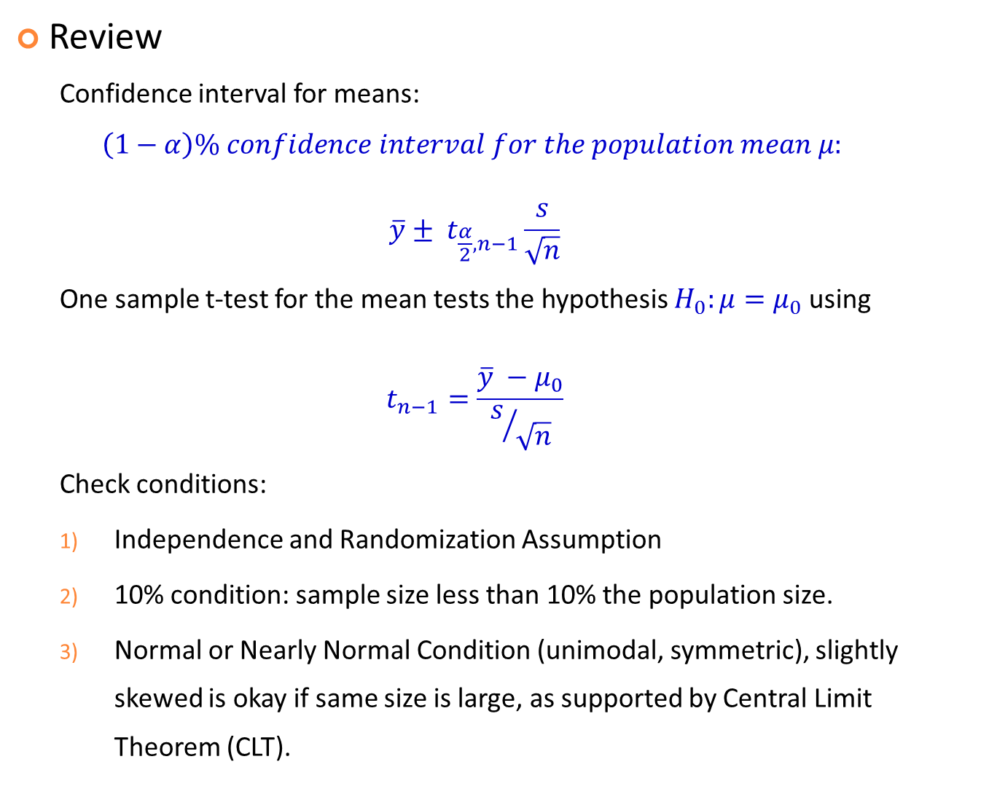
Review
  Confidence interval for means:
  $$\left(1−α\right)\% confidence interval for the population mean μ:$$
  $$\overline{y}± t_{\frac{α}{2}, n−1}\frac{s}{\sqrt{n}}$$
  One sample t-test for the mean tests the hypothesis $H_{0}:μ=μ_{0}$ using
  $$t_{n−1}=\frac{\overline{y} −μ_{0}}{s/{\sqrt{n}}}$$
  Check conditions:
  Independence and Randomization Assumption
  10% condition: sample size less than 10% the population size.
  Normal or Nearly Normal Condition (unimodal, symmetric), slightly skewed is okay if same size is large, as supported by Central Limit Theorem (CLT).

Slide 4
Review: T distribution with degree of freedom (df)
As degree of freedom (sample size-1) larger, T -> normal

Slide 5
Review: How to use T-table?
Suppose we want to be 95% confidence about the confidence interval we construct based on a random sample with size 30. We need the T critical value with degree of freedom 30-1=29, and two-tailed since we are constructing confidence interval.
cum. prob | t .50 | t .75 | t .80 | t .85 | t .90 | t .95 | t .975 | t .99 | t .995 | t .999 | t .9995
one-tail | 0.50 | 0.25 | 0.20 | 0.15 | 0.10 | 0.05 | 0.025 | 0.01 | 0.005 | 0.001 | 0.0005
two-tails | 1.00 | 0.50 | 0.40 | 0.30 | 0.20 | 0.10 | 0.05 | 0.02 | 0.01 | 0.002 | 0.001
df | 0.000 | 1.000 | 1.376 | 1.963 | 3.078 | 6.314 | 12.71 | 31.82 | 63.66 | 318.31 | 636.62
1
2 | 0.000 | 0.816 | 1.061 | 1.386 | 1.886 | 2.920 | 4.303 | 6.965 | 9.925 | 22.327 | 31.599
3 | 0.000 | 0.765 | 0.978 | 1.250 | 1.638 | 2.353 | 3.182 | 4.541 | 5.841 | 10.215 | 12.924
4 | 0.000 | 0.741 | 0.941 | 1.190 | 1.533 | 2.132 | 2.776 | 3.747 | 4.604 | 7.173 | 8.610
21 | 0.000 | 0.686 | 0.859 | 1.063 | 1.323 | 1.721 | 2.080 | 2.518 | 2.831 | 3.527 | 3.819
22 | 0.000 | 0.686 | 0.858 | 1.061 | 1.321 | 1.717 | 2.074 | 2.508 | 2.819 | 3.505 | 3.792
23 | 0.000 | 0.685 | 0.858 | 1.060 | 1.319 | 1.714 | 2.069 | 2.500 | 2.807 | 3.485 | 3.768
24 | 0.000 | 0.685 | 0.857 | 1.059 | 1.318 | 1.711 | 2.064 | 2.492 | 2.797 | 3.467 | 3.745
25 | 0.000 | 0.684 | 0.856 | 1.058 | 1.316 | 1.708 | 2.060 | 2.485 | 2.787 | 3.450 | 3.725
26 | 0.000 | 0.684 | 0.856 | 1.058 | 1.315 | 1.706 | 2.056 | 2.479 | 2.779 | 3.435 | 3.707
27 | 0.000 | 0.684 | 0.855 | 1.057 | 1.314 | 1.703 | 2.052 | 2.473 | 2.771 | 3.421 | 3.690
28 | 0.000 | 0.683 | 0.855 | 1.056 | 1.313 | 1.701 | 2.048 | 2.467 | 2.763 | 3.408 | 3.674
29 | 0.000 | 0.683 | 0.854 | 1.055 | 1.311 | 1.699 | 2.045 | 2.462 | 2.756 | 3.396 | 3.659
30 | 0.000 | 0.683 | 0.854 | 1.055 | 1.310 | 1.697 | 2.042 | 2.457 | 2.750 | 3.385 | 3.646
40 | 0.000 | 0.681 | 0.851 | 1.050 | 1.303 | 1.684 | 2.021 | 2.423 | 2.704 | 3.307 | 3.551
60 | 0.000 | 0.679 | 0.848 | 1.045 | 1.296 | 1.671 | 2.000 | 2.390 | 2.660 | 3.232 | 3.460
80 | 0.000 | 0.678 | 0.846 | 1.043 | 1.292 | 1.664 | 1.990 | 2.374 | 2.639 | 3.195 | 3.416
100 | 0.000 | 0.677 | 0.845 | 1.042 | 1.290 | 1.660 | 1.984 | 2.364 | 2.626 | 3.174 | 3.390
1000 | 0.000 | 0.675 | 0.842 | 1.037 | 1.282 | 1.646 | 1.962 | 2.330 | 2.581 | 3.098 | 3.300
z | 0.000 | 0.674 | 0.842 | 1.036 | 1.282 | 1.645 | 1.960 | 2.326 | 2.576 | 3.090 | 3.291
 | 0% | 50% | 60% | 70% | 80% | 90% | 95% | 98% | 99% | 99.8% | 99.9%
 | Confidence Level

Slide 6
Review
  Try to answer following questions:
  How to check the conditions? From which aspects?
  How to construct the confidence interval given confidence level?
  How to interpret the confidence interval you constructed?
  How to interpret the phrase “with (1 - 𝛼)% confidence”?
  Now you are ready to solve the problems.

Slide 7
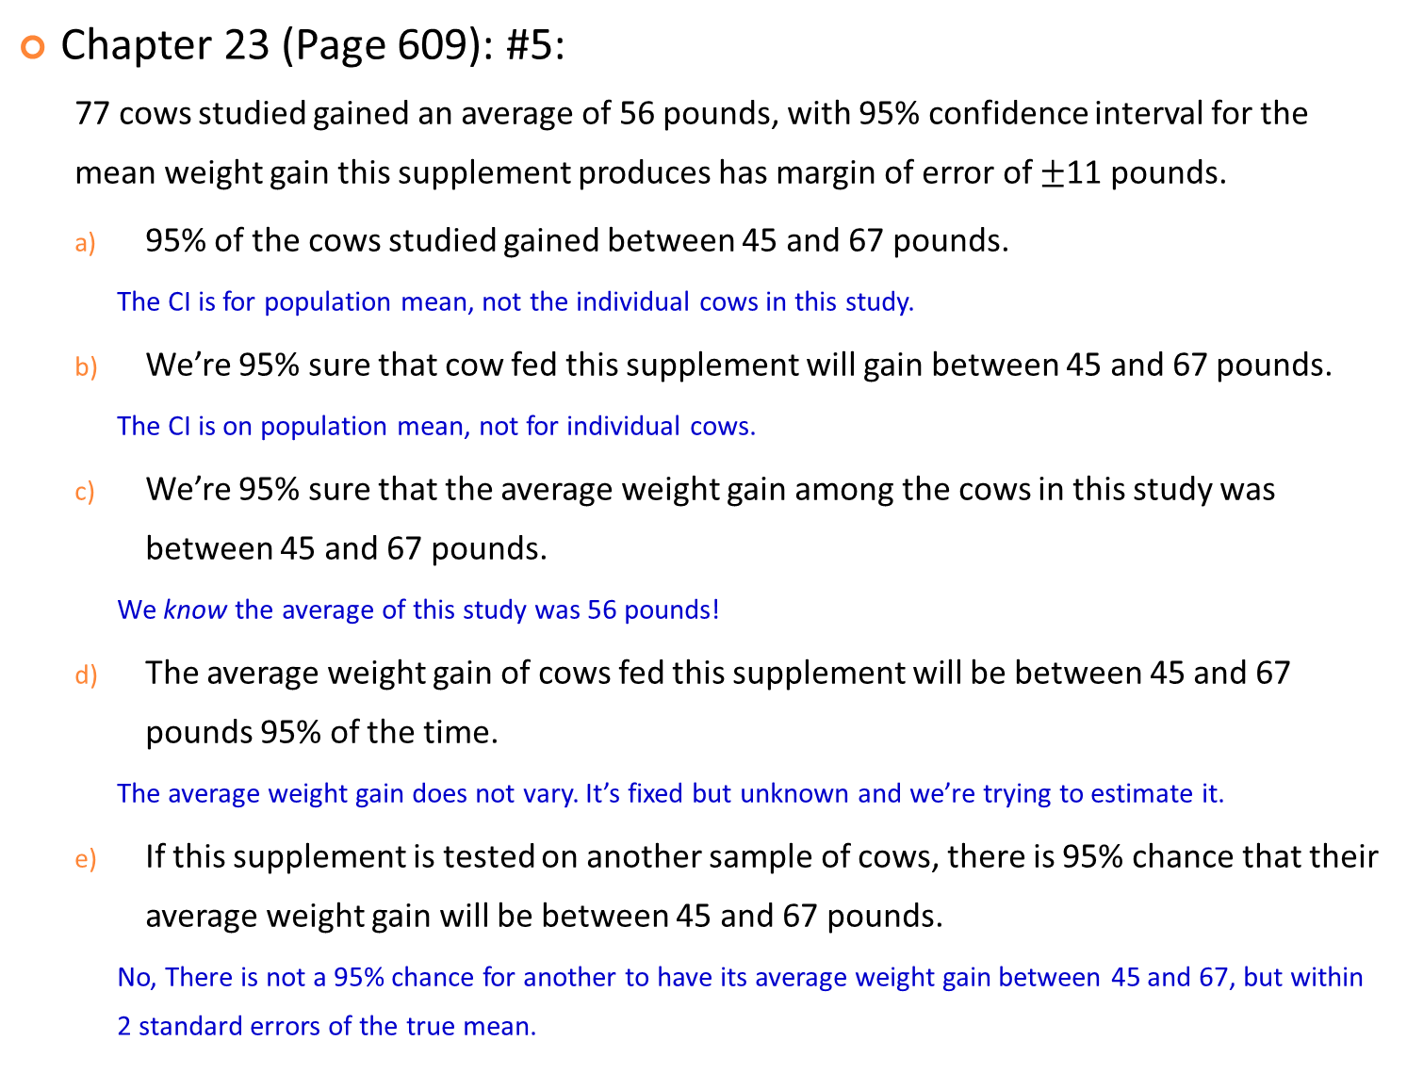
Chapter 23 (Page 609): #5:
  77 cows studied gained an average of 56 pounds, with 95% confidence interval for the mean weight gain this supplement produces has margin of error of $±$11 pounds.
  95% of the cows studied gained between 45 and 67 pounds.
    The CI is for population mean, not the individual cows in this study.
  We’re 95% sure that cow fed this supplement will gain between 45 and 67 pounds.
    The CI is on population mean, not for individual cows.
  We’re 95% sure that the average weight gain among the cows in this study was between 45 and 67 pounds.
    We know the average of this study was 56 pounds!
  The average weight gain of cows fed this supplement will be between 45 and 67 pounds 95% of the time.
    The average weight gain does not vary. It’s fixed but unknown and we’re trying to estimate it.
  If this supplement is tested on another sample of cows, there is 95% chance that their average weight gain will be between 45 and 67 pounds.
    No, There is not a 95% chance for another to have its average weight gain between 45 and 67, but within 2 standard errors of the true mean.

Slide 8
Chapter 23 (Page 609): #6:
  A random sample of 288 Nevada teachers produces the t-interval for mean salary: 38944<mean salary<42893 with 90% confidence.
  If we took many random samples of Nevada teachers, about 9 out of 10 out them would produce this confidence interval.
  If we took many random samples of Nevada teachers, about 9 out of 10 out them would produce a confidence interval that contained the mean salary of all Nevada teachers.
  About 9 out of 10 Nevada teachers earn between $38,944 and $42,893
  About 9 out of 10 Nevada teachers surveyed earn between $38,944 and $42,893
  We are 90% confident that the average teacher salary in the U.S. is between $38,944 and $42,893.


Slide 9
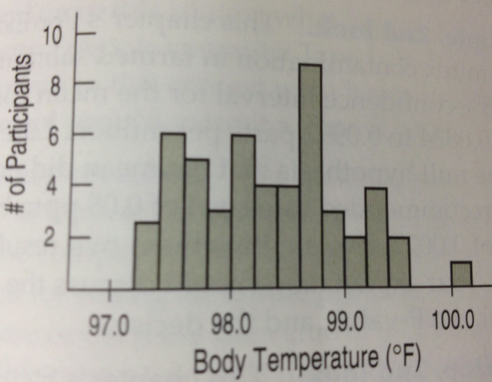
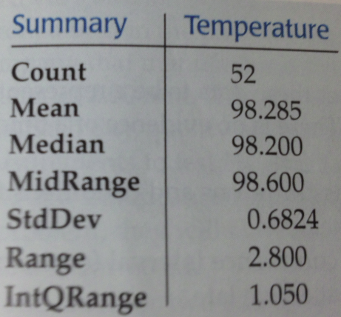
Chapter 23 (Page 611): #13:
  A histogram of body temperature for randomly selected adults.

Slide 10
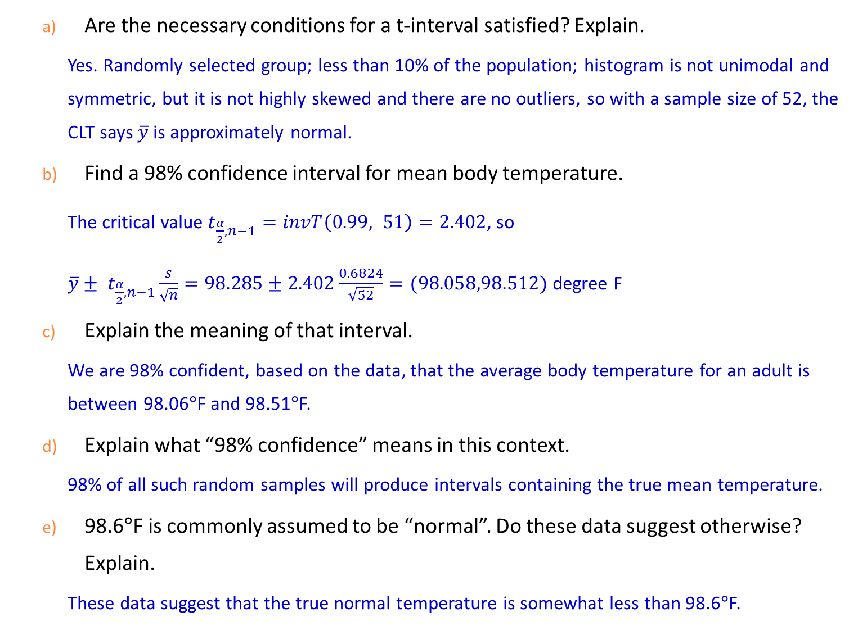
  Are the necessary conditions for a t-interval satisfied? Explain.
    Yes. Randomly selected group; less than 10% of the population; histogram is not unimodal and symmetric, but it is not highly skewed and there are no outliers, so with a sample size of 52, the CLT says $\overline{y}$ is approximately normal.
  Find a 98% confidence interval for mean body temperature.
    The critical value $t_{\frac{α}{2}, n−1}=invT\left(0.99, 51\right)=2.402$, so
    $\overline{y}± t_{\frac{α}{2}, n−1}\frac{s}{\sqrt{n}}=98.285±2.402\frac{0.6824}{\sqrt{52}}=(98.058,98.512)$ degree F
  Explain the meaning of that interval.
    We are 98% confident, based on the data, that the average body temperature for an adult is between 98.06°F and 98.51°F.
  Explain what “98% confidence” means in this context.
    98% of all such random samples will produce intervals containing the true mean temperature.
  98.6°F is commonly assumed to be “normal”. Do these data suggest otherwise? Explain.
    These data suggest that the true normal temperature is somewhat less than 98.6°F.

Slide 11
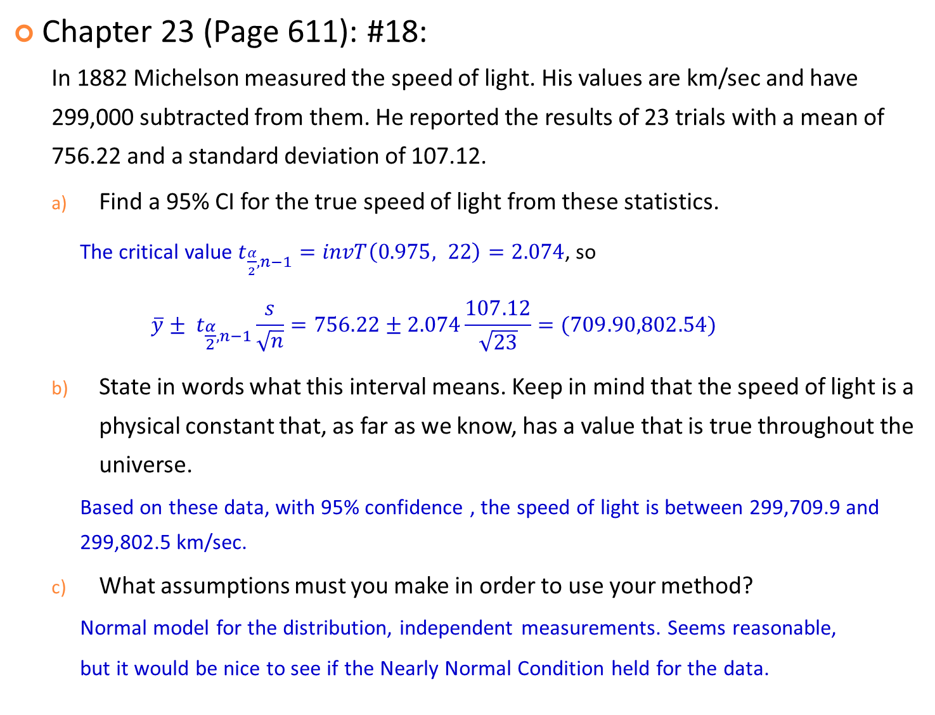
Chapter 23 (Page 611): #18:
  In 1882 Michelson measured the speed of light. His values are km/sec and have 299,000 subtracted from them. He reported the results of 23 trials with a mean of 756.22 and a standard deviation of 107.12.
  Find a 95% CI for the true speed of light from these statistics.
    The critical value $t_{\frac{α}{2}, n−1}=invT\left(0.975, 22\right)=2.074$, so
    $$\overline{y}± t_{\frac{α}{2}, n−1}\frac{s}{\sqrt{n}}=756.22±2.074\frac{107.12}{\sqrt{23}}=(709.90,802.54)$$
  State in words what this interval means. Keep in mind that the speed of light is a physical constant that, as far as we know, has a value that is true throughout the universe.
    Based on these data, with 95% confidence , the speed of light is between 299,709.9 and 299,802.5 km/sec.
  What assumptions must you make in order to use your method?
    Normal model for the distribution, independent measurements. Seems reasonable,
    but it would be nice to see if the Nearly Normal Condition held for the data.

Slide 12
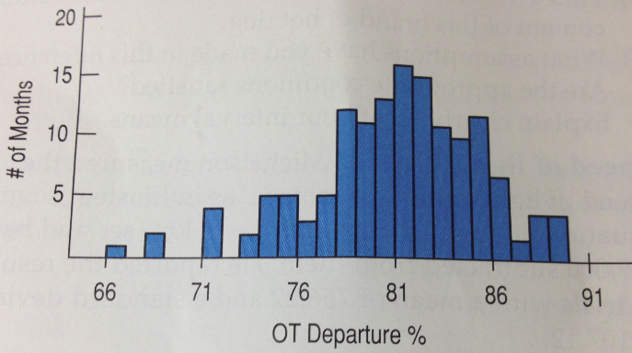
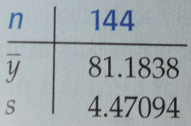
Chapter 23 (Page 612): #21:
  What are the chances your flight will leave on time? Here is a histogram and summary statistics for the percentages of flights departure on time each month from 1995 thru 2006. There is no evidence of a trend over time. (The correlation of On Time Departure% and time is r = -0.016.)

Slide 13
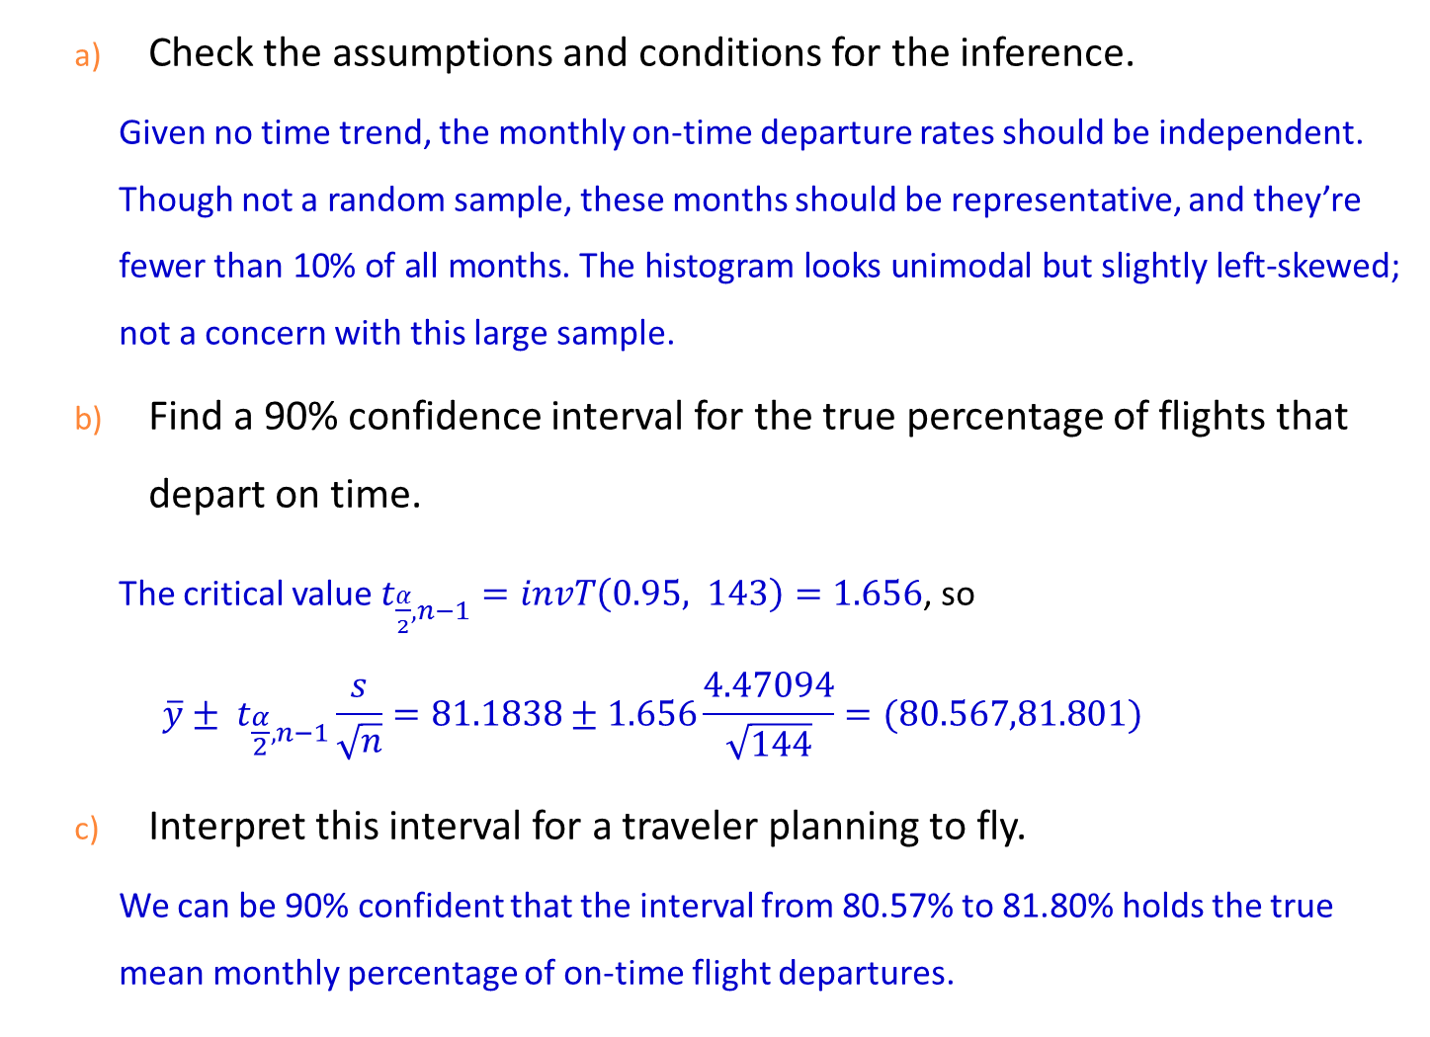
  Check the assumptions and conditions for the inference.
    Given no time trend, the monthly on-time departure rates should be independent. Though not a random sample, these months should be representative, and they’re fewer than 10% of all months. The histogram looks unimodal but slightly left-skewed; not a concern with this large sample.
  Find a 90% confidence interval for the true percentage of flights that depart on time.
    The critical value $t_{\frac{α}{2}, n−1}=invT\left(0.95, 143\right)=1.656$, so
    $$\overline{y}± t_{\frac{α}{2}, n−1}\frac{s}{\sqrt{n}}=81.1838±1.656\frac{4.47094}{\sqrt{144}}=(80.567,81.801)$$
  Interpret this interval for a traveler planning to fly.
    We can be 90% confident that the interval from 80.57% to 81.80% holds the true mean monthly percentage of on-time flight departures.

Slide 14
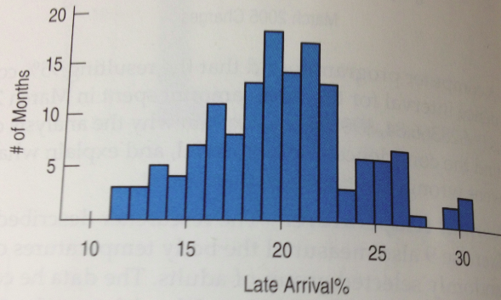
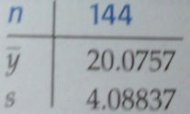
Chapter 23 (Page 612): #22:
  Will your flight get you to your destination on time? Here is a histogram and summary statistics of late arrivals. There is no evidence of a trend over time. (The correlation of On Time Departure% and time is r = -0.07.)

Slide 15
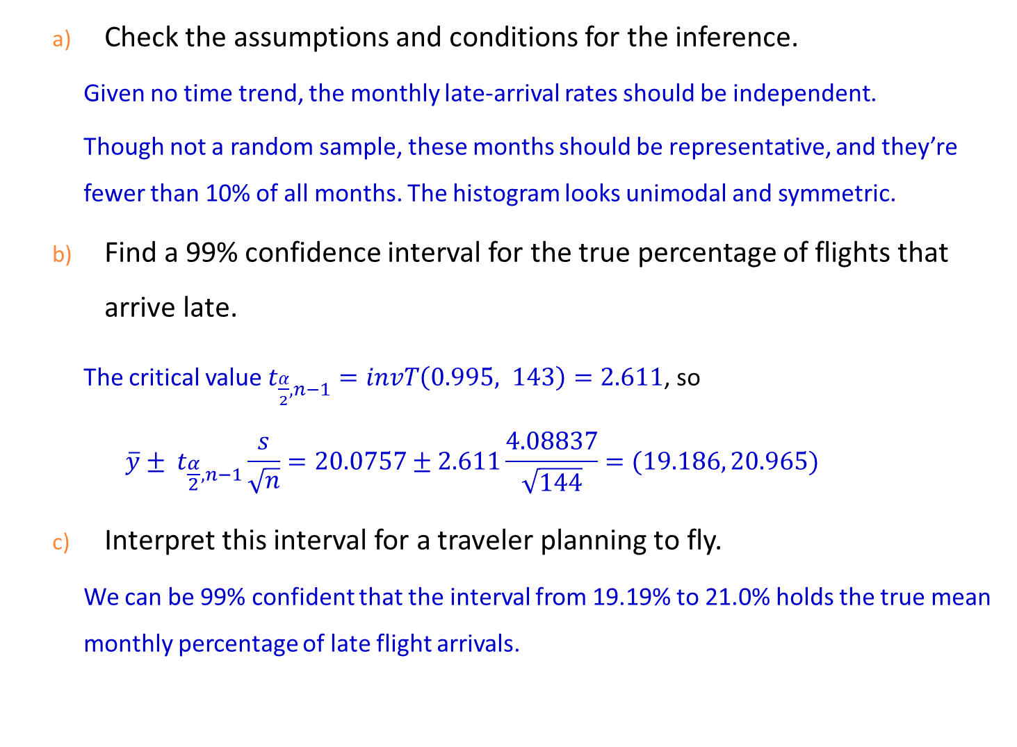
  Check the assumptions and conditions for the inference.
    Given no time trend, the monthly late-arrival rates should be independent.
    Though not a random sample, these months should be representative, and they’re fewer than 10% of all months. The histogram looks unimodal and symmetric.
  Find a 99% confidence interval for the true percentage of flights that arrive late.
    The critical value $t_{\frac{α}{2}, n−1}=invT\left(0.995, 143\right)=2.611$, so
    $$\overline{y}± t_{\frac{α}{2}, n−1}\frac{s}{\sqrt{n}}=20.0757±2.611\frac{4.08837}{\sqrt{144}}=(19.186, 20.965)$$
  Interpret this interval for a traveler planning to fly.
    We can be 99% confident that the interval from 19.19% to 21.0% holds the true mean monthly percentage of late flight arrivals.

Slide 16
Thank you.

