Slide 1
STT 200 – Lecture 1, section 2,4 Recitation 9 (10/30/2012)
TA: Zhen (Alan) Zhang
zhangz19@stt.msu.edu
Office hour: (C500 WH) 1:45 – 2:45PM Tuesday
(office tel.: 432-3342)
Help-room: (A102 WH) 11:20AM-12:30PM, Monday, Friday
Class meet on Tuesday:
3:00 – 3:50PM A122 WH, Section 02
12:40 – 1:30PM A322 WH, Section 04

Slide 2
Overview
We will discuss following problems:
Chapter 15 “Probability Rules” (Page 404)
# 8, 13, 14, 16, 17, 18
All recitation PowerPoint slides available at here

Slide 3
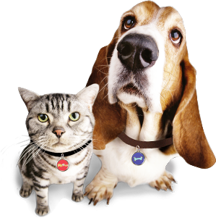
Chapter 15 (Page 404): #8:
Dogs: 24 (8 males); cats: 18 (6 males).
An animal is selected randomly. Find the probability:
The pet is male, given it is a cat
The total number of animals is 24 + 18 = 42
$$P\left(male | cat\right)=\frac{P\left(male and cat\right)}{P\left(cat\right)}=\frac{6/42}{18/42}=0.333$$
The pet is cat, given it is female
$$P\left(cat | female\right)=\frac{P\left(cat and female\right)}{P\left(female\right)}= \frac{(18−6)/42}{(18−6+24−8)/42}= \frac{12}{28}=0.429$$
The pet is female, given it is a dog
$$P\left(female | dog\right)=\frac{P\left(female and dog\right)}{P\left(dog\right)}=\frac{(24−8)/42}{24/42}=\frac{16}{24}= 0.667$$

Slide 4
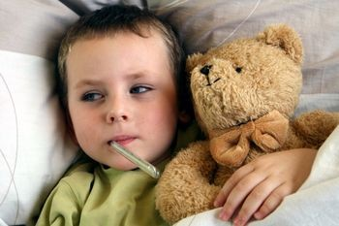
Chapter 15 (Page 405): #13:
70% kids have a fever, 30% kids with fever have sore throats.
What is the probability that a kid has a fever and a sore throats?
$P\left(fever and sore throats\right)$
$$=P\left(sore throats\right|fever)×P\left(fever\right)=0.3 ×0.7=0.21$$

Slide 5
Chapter 15 (Page 405): #14:
20% of cars have faulty pollution control systems.
The cost of repairing exceeds $100 about 40% of the time.
What is the probability that a driver ends up paying more than $100 to repair when doing car inspection?
$P\left(have problem and pay more than \$100\right)$
$$=P\left(pay more than \$100\right|have problem)×P\left(have problem\right)=0.4×0.2=0.08$$

Slide 6
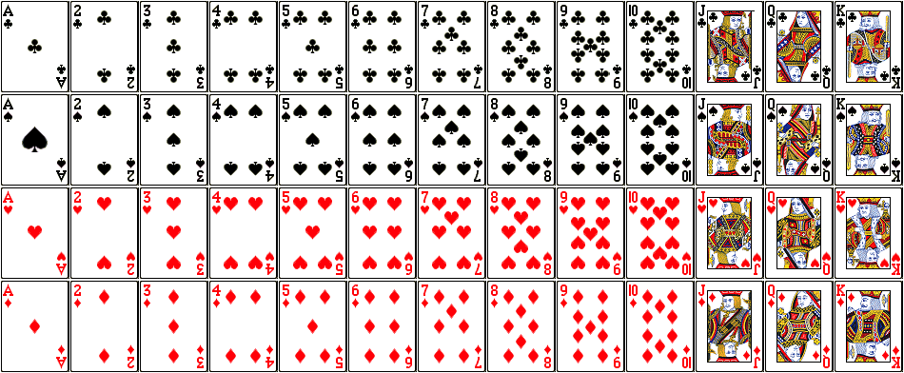
Chapter 15 (Page 405): #16:
Paly cards: There are $13×4=52$ play cards in total.
From top to bottom: Clubs, Spades, Hearts, Diamonds.

Slide 7
Chapter 15 (Page 405): #16 Questions:
Pick up 3 cards at random from a deck. Find the probability:
You get no aces
$$P\left(no aces\right)=\frac{48}{52}×\frac{47}{51}×\frac{46}{50}=0.783$$
You get all hearts
$$P\left(all hearts\right)=\frac{13}{52}×\frac{12}{51}×\frac{11}{50}=0.013$$
The third card is your first red card
$$P\left(3rd card first red\right)=\frac{26}{52}×\frac{25}{51}×\frac{26}{50}=0.127$$
You have at least one diamond
$$P\left(≥1 diamond\right)=1−P\left(no diamond\right)=1−\frac{39}{52}×\frac{38}{51}×\frac{37}{50}=0.586$$

Slide 8
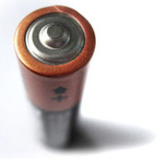
Chapter 15 (Page 405): #17:
A junk box contains a dozen old batteries, with 5 totally dead. You start picking batteries one at a time and testing them. Find the probability:
The first two you choose are both good
$P\left(first two good\right)=\frac{7}{12}×\frac{6}{11}=0.318$
At least one of the first three works
$P\left(≥1 good\right)=1−P\left(no good\right)=1−\frac{5}{12}×\frac{4}{11}×\frac{3}{10}=0.955$
The first four you pick all work
$$P\left(all good\right)=\frac{7}{12}×\frac{6}{11}×\frac{5}{10}×\frac{4}{9}=0.071$$
You have to pick 5 batteries in order to find one that works
$$P\left(4 dead, last 1 good\right)=\frac{5}{12}×\frac{4}{11}×\frac{3}{10}×\frac{2}{9}×\frac{7}{8}=0.009$$

Slide 9
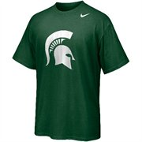
Chapter 15 (Page 405): #18:
Shirts size: medium (4), large (10), extra-large (6). You want a medium for two persons. Find the probability
The first two you grab are the wrong sizes
$P\left(first two not medium\right)=\frac{16}{20}×\frac{15}{19}=0.632$
The first medium you find is the third one you check
$P\left(first 2 not medium, third is\right)=\frac{16}{20}×\frac{15}{19}×\frac{4}{18}=0.140$
The first four shirts you pick are all extra-large
$$P\left(first 4 extra−large\right)=\frac{6}{20}×\frac{5}{19}×\frac{4}{18}×\frac{3}{17}=0.003$$
At least one of the first four shirts you check is a medium
$P\left(≥1 medium\right)=1−P\left(no medium\right)=1−\frac{16}{20}×\frac{15}{19}×\frac{14}{18}×\frac{13}{17}=0.624$

Slide 10
Thank you.

